Slide 1
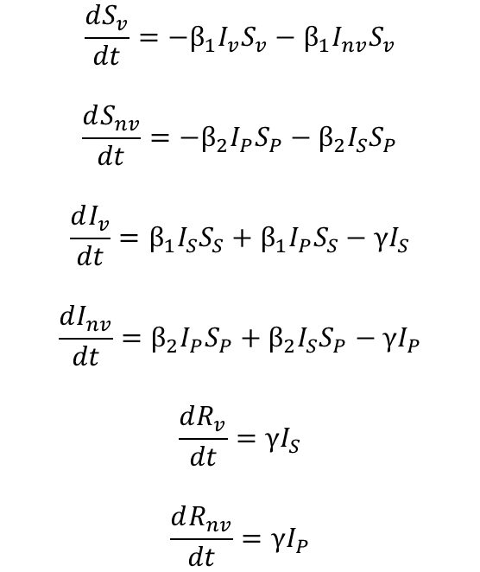
Model Equations
“Shielded”
Population
S_{v}
β₁I_{v}S_{v}
I_{v}
γI_{v}
R
$$\frac{dS_{v}}{dt}=−β_{1}I_{v}S_{v}−β_{1}I_{nv}S_{v}$$
$$\frac{dS_{nv}}{dt}=−β_{2}I_{P}S_{P}−β_{2}I_{S}S_{P}$$
$$\frac{dI_{v}}{dt}=β_{1}I_{S}S_{S}+β_{1}I_{P}S_{S}−γI_{S}$$
$$\frac{dI_{nv}}{dt}=β_{2}I_{P}S_{P}+β_{2}I_{S}S_{P}−γI_{P}$$
$$\frac{dR_{v}}{dt}=γI_{S}$$
$$\frac{dR_{nv}}{dt}=γI_{P}$$
β₁I_{nv}S_{v}
β₂I_{v}S_{nv}
“non-Shielded”
Population
S_{nv}
I_{nv}
R
β₂I_{nv}S_{nv}
γI_{nv}
Phase | Weeks | Beta1 | Beta2
0 | Up to I(t) = 0.0182 | 0.161 | 0.161
1 | 0-6 | 0.064 | 0.064
2 | 6-30 | 0.064/0.032/0 | 0.161
3 | 30 onwards | 0.161 | 0.161
4 | If phase 3 ends | 0.258 | 0.258
Phase | Weeks | Beta1 | Beta2
0 | Up to I(t) = 0.0182 | 0.161 | 0.161
1 | 0-6 | 0.097 | 0.097
2 | 6-30 | 0.097/0.049/0 | 0.161
3 | 30 onwards | 0.161 | 0.161
4 | If phase 3 ends | 0.258 | 0.258
BASELINE
RWC
Initial Conditions
Sv | Snv | Iv | Inv | Rv | Rnv
0.2 | 0.7999 | 0 | 0.0001 | 0 | 0
Equivalent to R0 = 2.4 -> 1.5 -> 0.6/0.3/0 -> 2.4

Slide 2
SIR Model
Repeat the sensitivity analysis with RWC scenario parameters – and the 2 other scenarios (0.049 and 0).
Sensitivity analysis comparing
Baseline SIR scenario with beta2 in phase 3 at full effect for 24 weeks
beta2 in Phase 3 tapered from no effect to full effect after 12 weeks + full effect for next 12 weeks
beta2 in Phase 3 tapered to full effect at 24 weeks

Slide 3
ONLY RWC Comparison (0.097, 0.049, 0) for Beta1 Phase 2

Slide 4
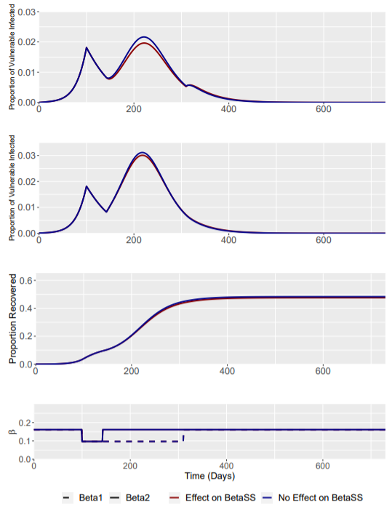
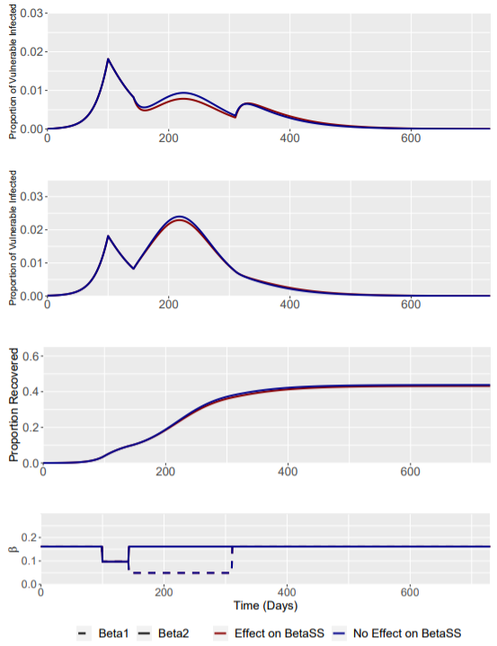
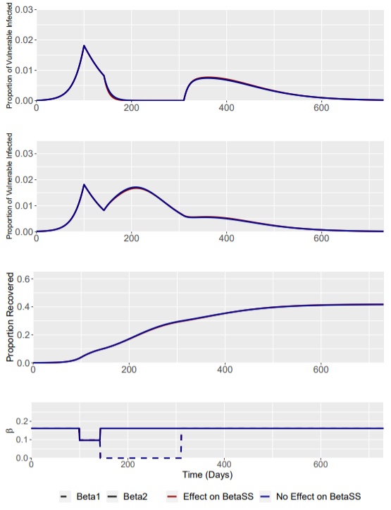
No Effect of Intervention on β_{SS}
Removing the effect of the intervention on β_{SS} transmission has very little effect on the overall model transmission dynamics.
NOTE THAT SECOND ROW IS NON-VULNERABLE
RWC Phase 2 (Beta1 = 0.097)
RWC Phase 2 (Beta1 = 0.049)
RWC Phase 2 (Beta1 = 0)

Slide 5
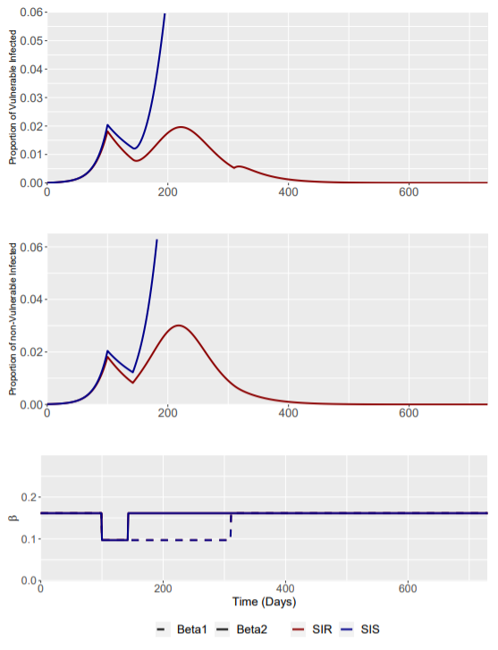
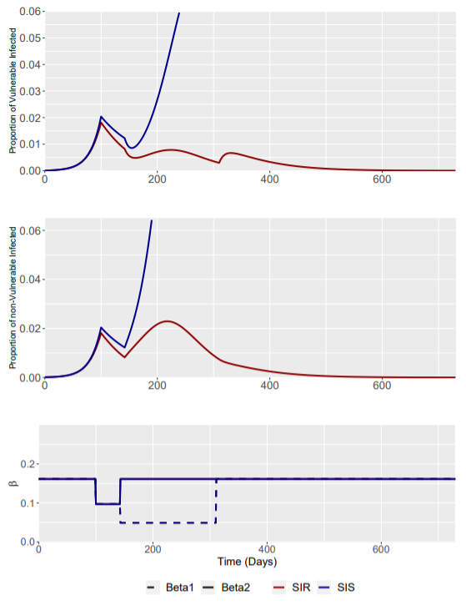
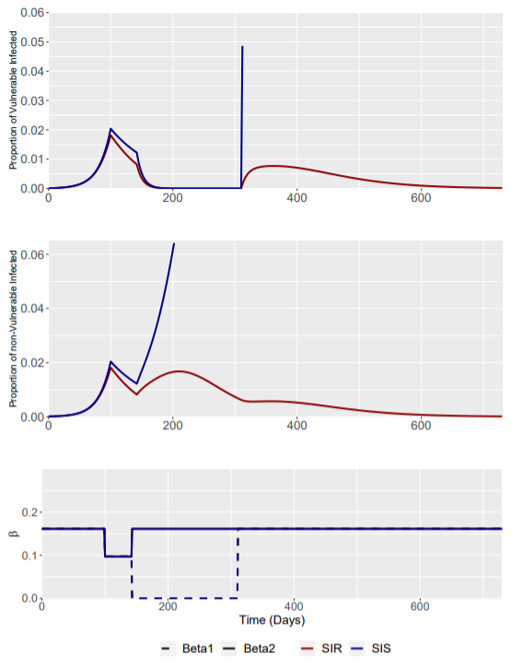
SIS vs SIR Model
The loss of immunity has significant effects on the transmission dynamics of the modelled disease.
Some figures appear to “end” early – this is because the next time point I(t) (often after intervention is released) is beyond the y-axis limits (0.06 and 0.065)
RWC Phase 2 (Beta1 = 0.097)
RWC Phase 2 (Beta1 = 0.049)
RWC Phase 2 (Beta1 = 0)

Slide 6
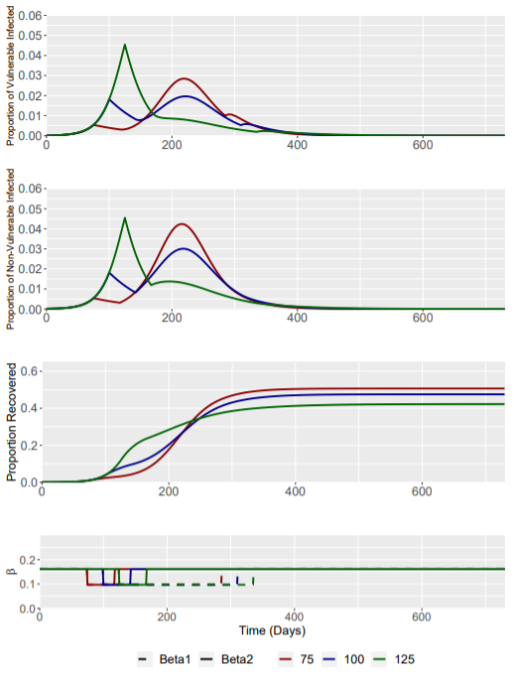
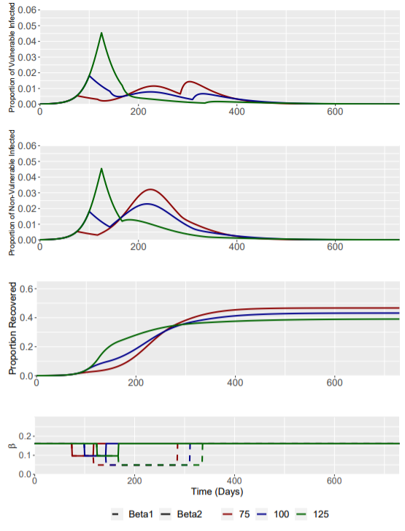
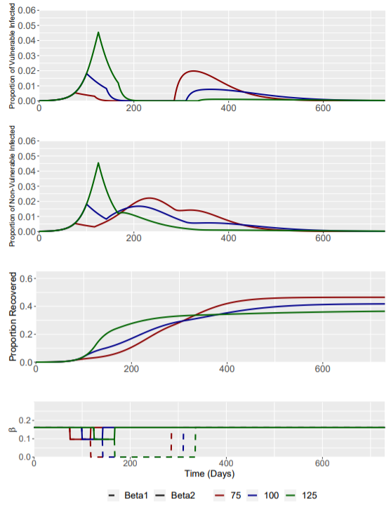
Different Intervention Triggers – I(t) = 0.0054 (day 75), 0.0182 (day 100) and 0.0454 (day 125)
RWC Phase 2 (Beta1 = 0.097)
RWC Phase 2 (Beta1 = 0.049)
RWC Phase 2 (Beta1 = 0)

Slide 7
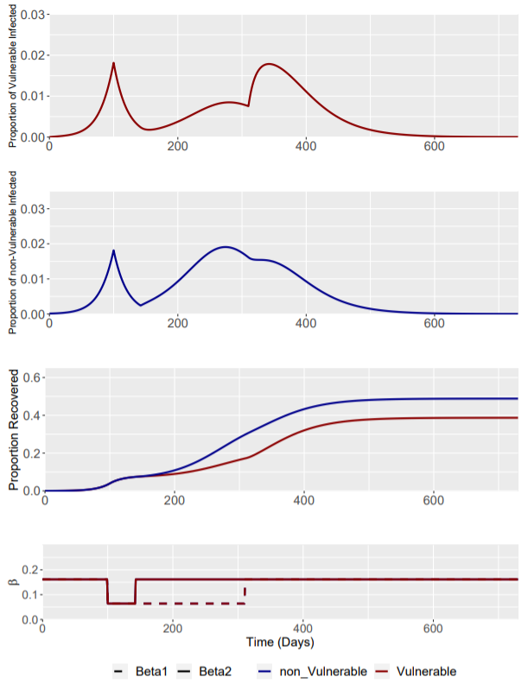
Baseline Scenario: Phase 2 β1 = 0.064
Phase | Weeks | Beta1 | Beta2
0 | Up to I(t) = 0.0182 | 0.161 | 0.161
1 | 0-6 | 0.064 | 0.064
2 | 6-30 | 0.064 | 0.161
3 | 30 onwards | 0.161 | 0.161
β1 remains static at 0.064 throughout the phase 1 and 2 of the intervention.
This is the baseline model for the enhanced shielding intervention.
Intervention trigger is at I(t) = 0.0182

Slide 8
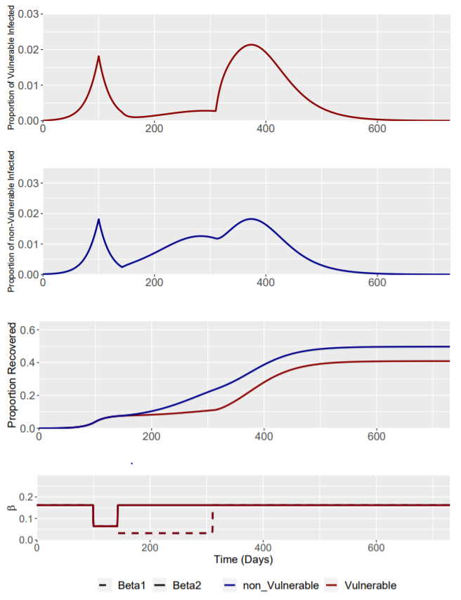
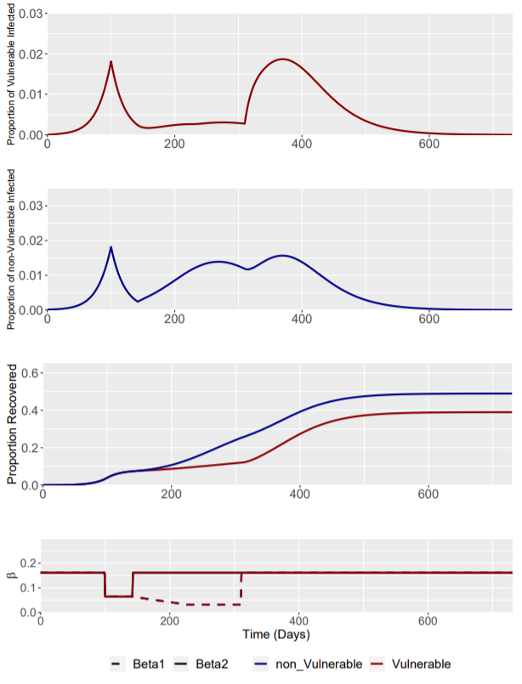
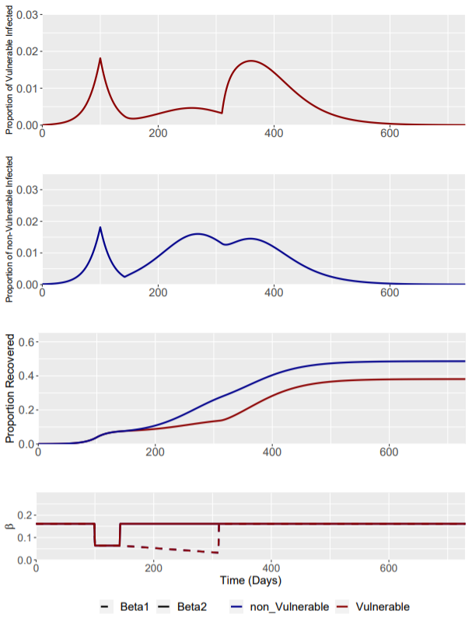
Scenario: Phase 2 β1 = 0.032
Phase | Weeks | Beta1 | Beta2
0 | Up to I(t) = 0.0182 | 0.161 | 0.161
1 | 0-6 | 0.064 | 0.064
2 | 6-30 | 0.032 | 0.161
3 | 30 onwards | 0.161 | 0.161
3 Phase 2 interventions are explored:
Constant Phase 2 β1 intervention at 0.032 for 24 weeks
“Ramp-up” 1 Phase 2 intervention with β1 linearly reduced to 0.032 by week 12 and remaining static at 0.032 for the remaining 12 weeks of phase 2
“Ramp-up” 2 Phase 2 intervention linearly reducing β1 to 0.032 throughout the 24 week intervention, reaching 0.032 at week 24
Phase 2: Constant
Phase 2: “Ramp up” 1
Phase 2: “Ramp up” 2

Slide 9
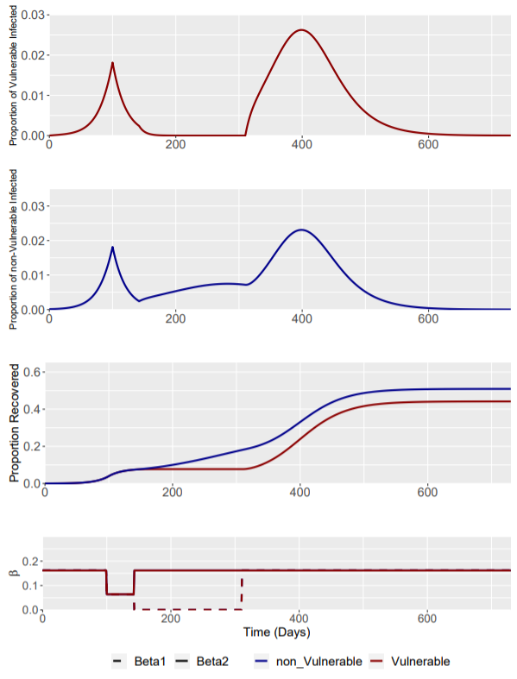
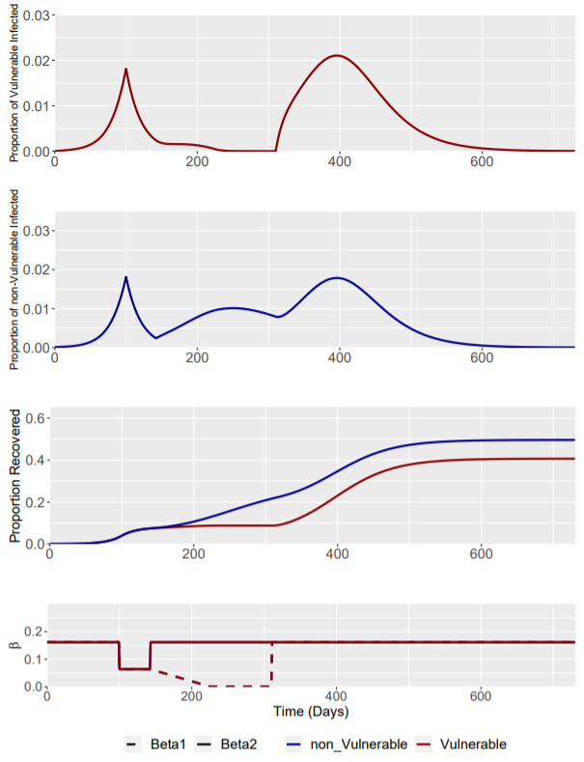
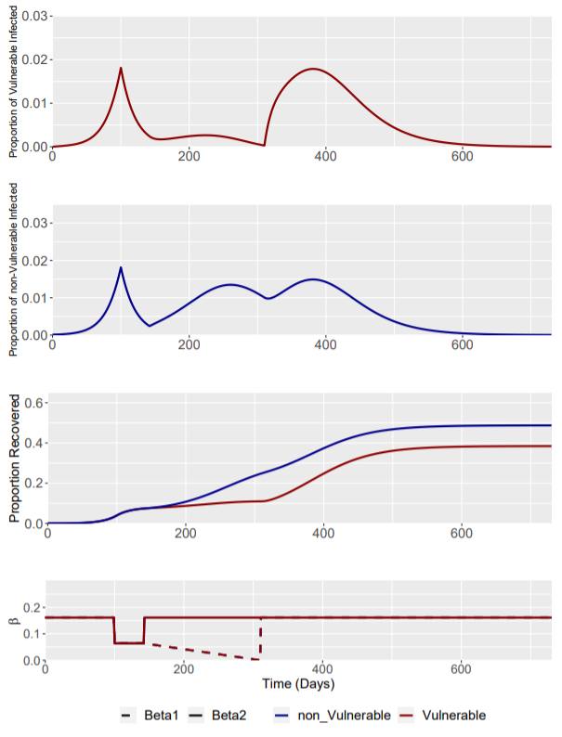
Scenario: Phase 2 β1 = 0
Phase | Weeks | Beta1 | Beta2
0 | Up to I(t) = 0.0182 | 0.161 | 0.161
1 | 0-6 | 0.064 | 0.064
2 | 6-30 | 0 | 0.161
3 | 30 onwards | 0.161 | 0.161
3 Phase 2 interventions are explored:
Constant Phase 2 β1 intervention at 0 for 24 weeks
“Ramp-up” 1 Phase 2 intervention with β1 linearly reduced to 0.032 by week 12 and remaining static at 0 for the remaining 12 weeks of phase 2
“Ramp-up” 2 Phase 2 intervention linearly reducing β1 to 0.032 throughout the 24 week intervention, reaching 0 at week 24
Phase 2: Constant
Phase 2: “Ramp up” 1
Phase 2: “Ramp up” 2

Slide 10
SIS Model
Explore the SIS model and the effect of indefinite length interventions – explore how we can prevent the SIS model taking off.

Slide 11
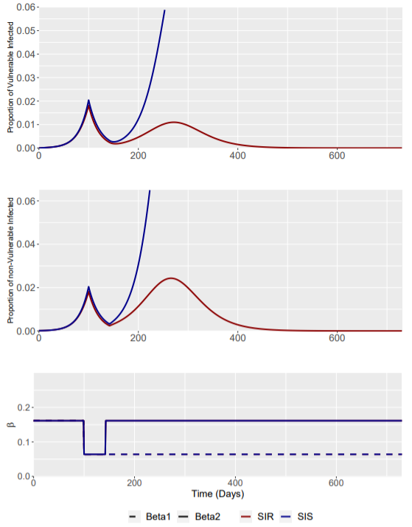
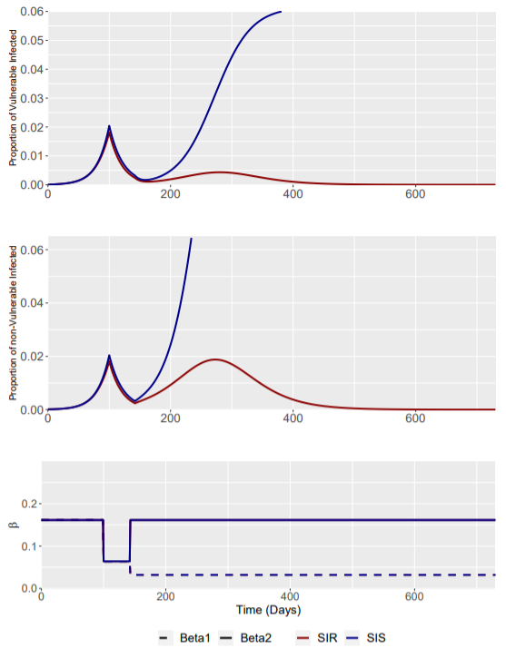
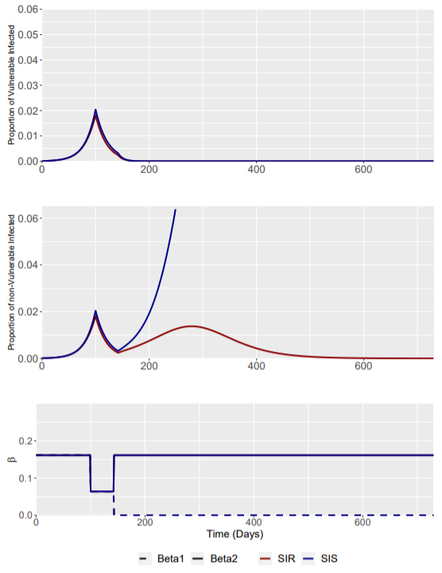
Interventions were assumed to last indefinitely to beta1 (the shielded population).
Only beta1 reductions to 0 were able to prevent Iv(t) increasing above 0.0182 – However, sustaining an intervention of this magnitude indefinitely is extremely difficult.
Phase 2 (Beta1 = 0.064)
Phase 2 (Beta1 = 0.032)
Phase 2 (Beta1 = 0)

Slide 12
SIRS Model
Implement the RWC scenario and the alternative beta1 (0.064, 0.032 and 0) parameters for the SIRS model – identify the resulting trajectory plots
Vary the timeline to see if it reaches equilibrium

Slide 13
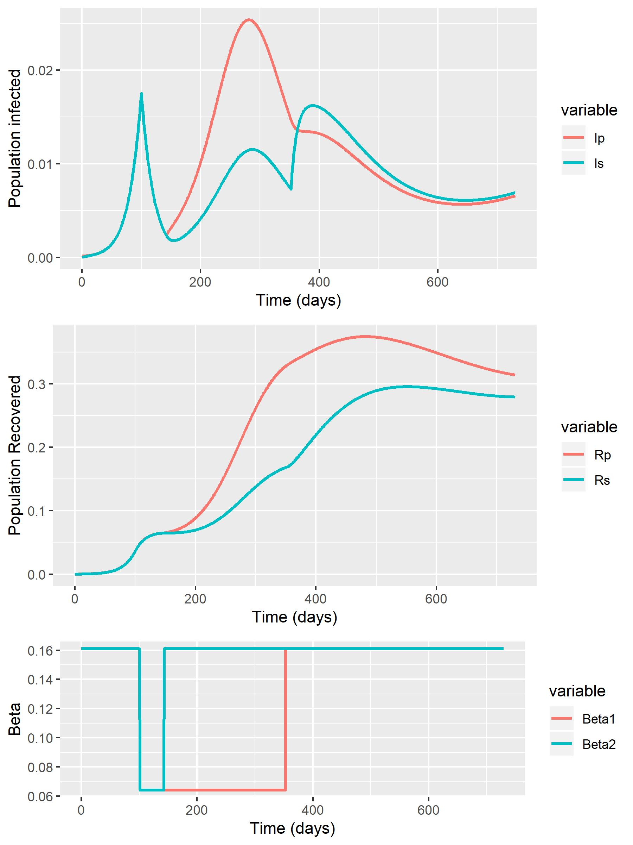
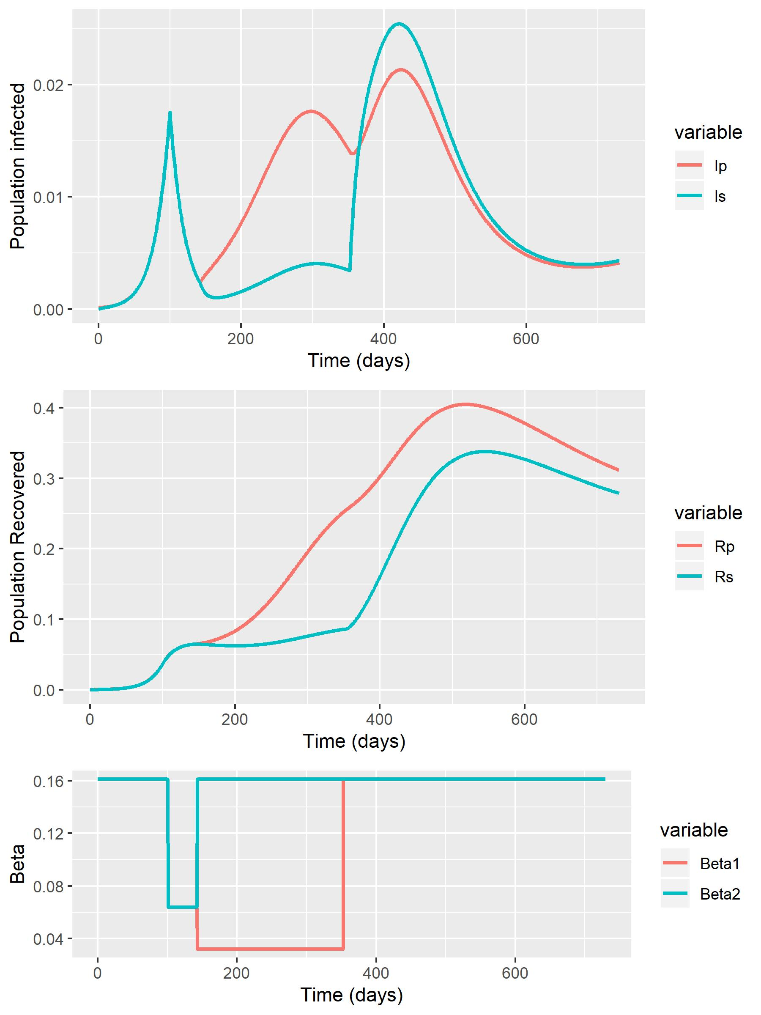
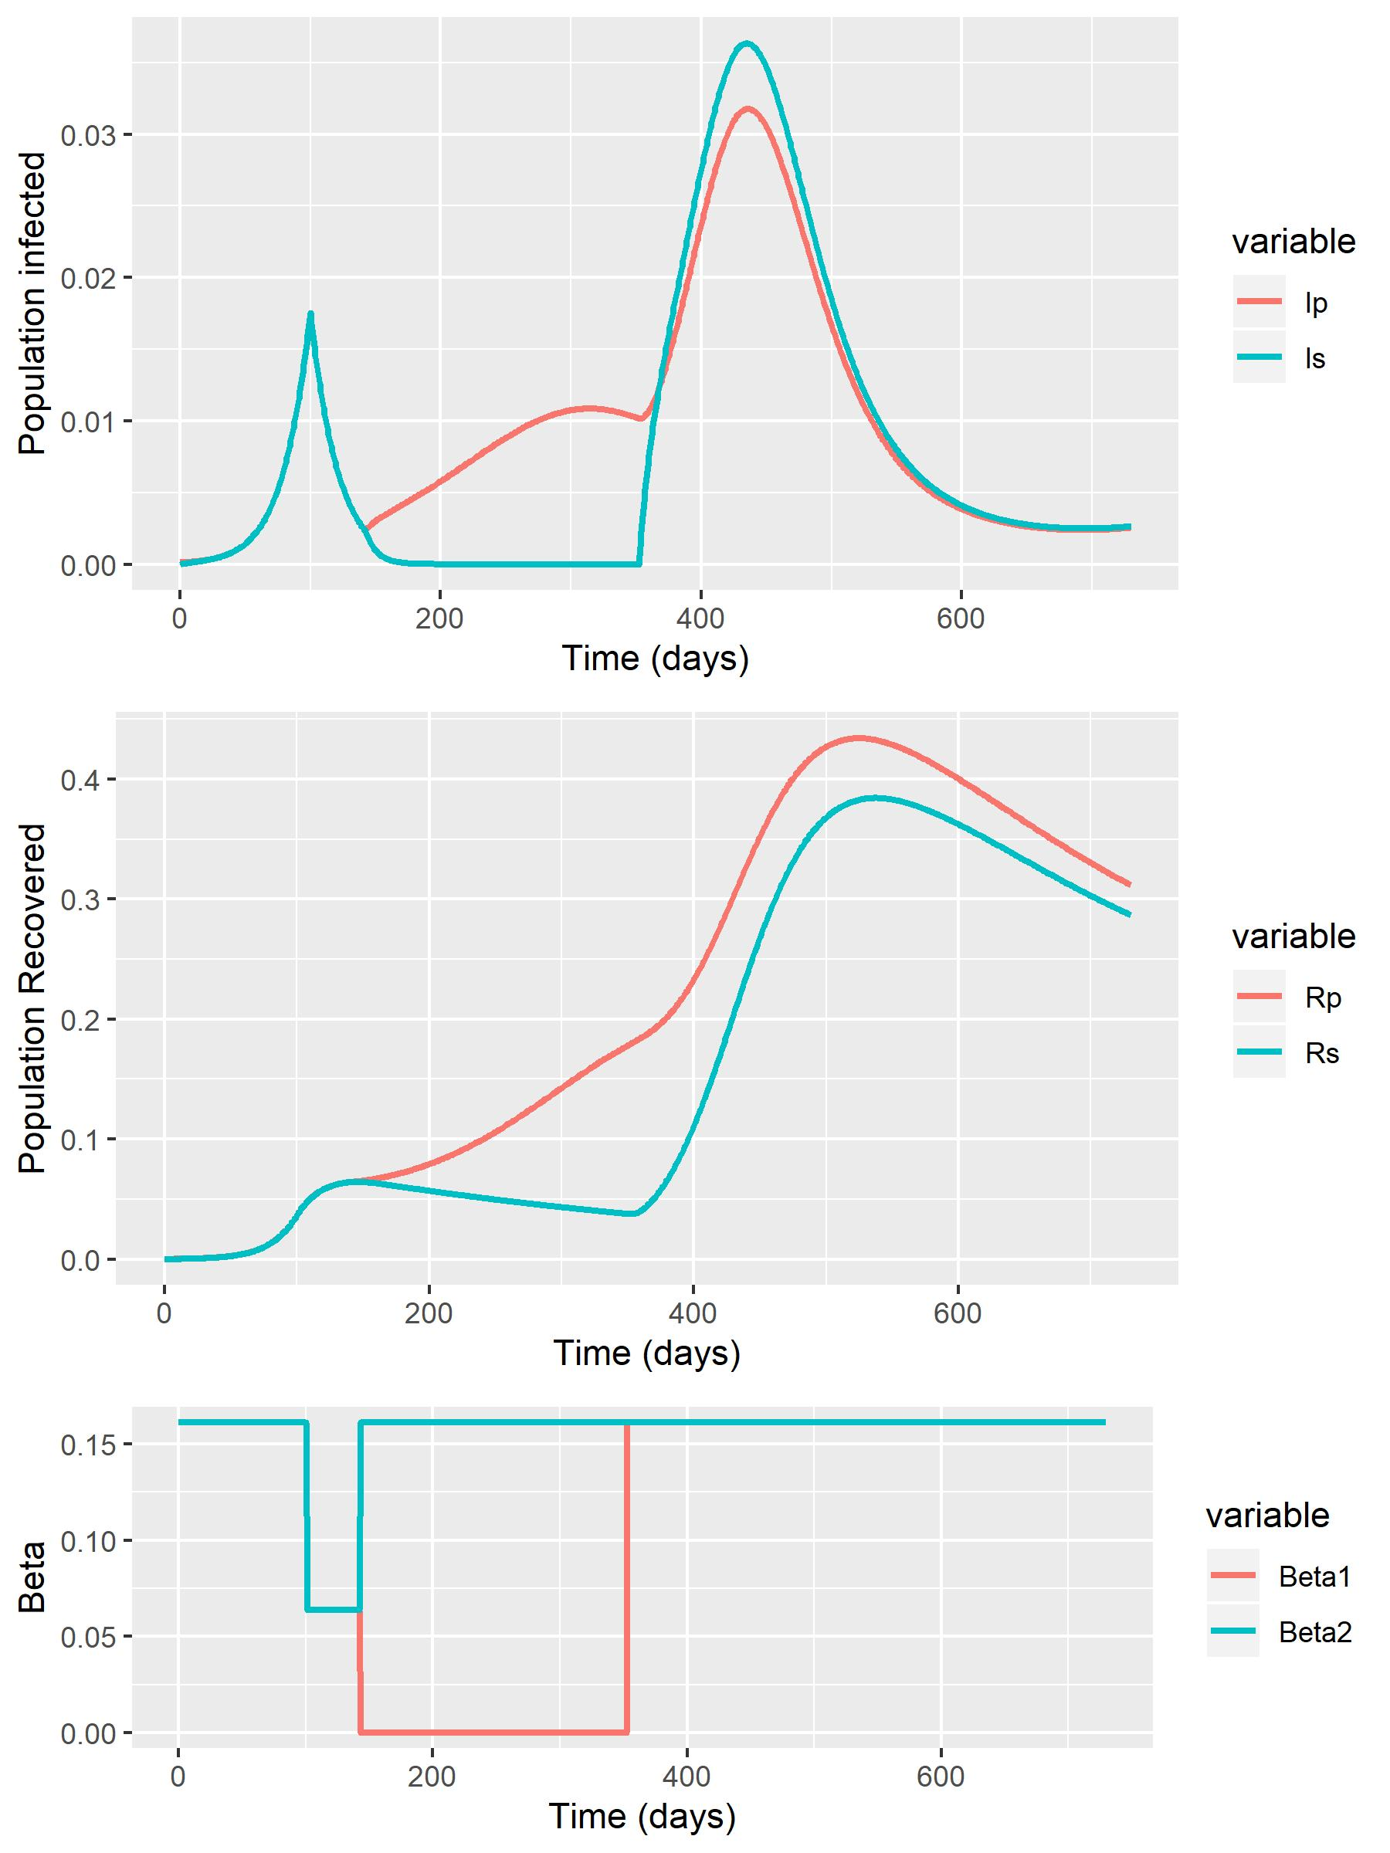
Baseline
Phase 2 (Beta1 = 0.064)
Phase 2 (Beta1 = 0.032)
Phase 2 (Beta1 = 0)

Slide 14
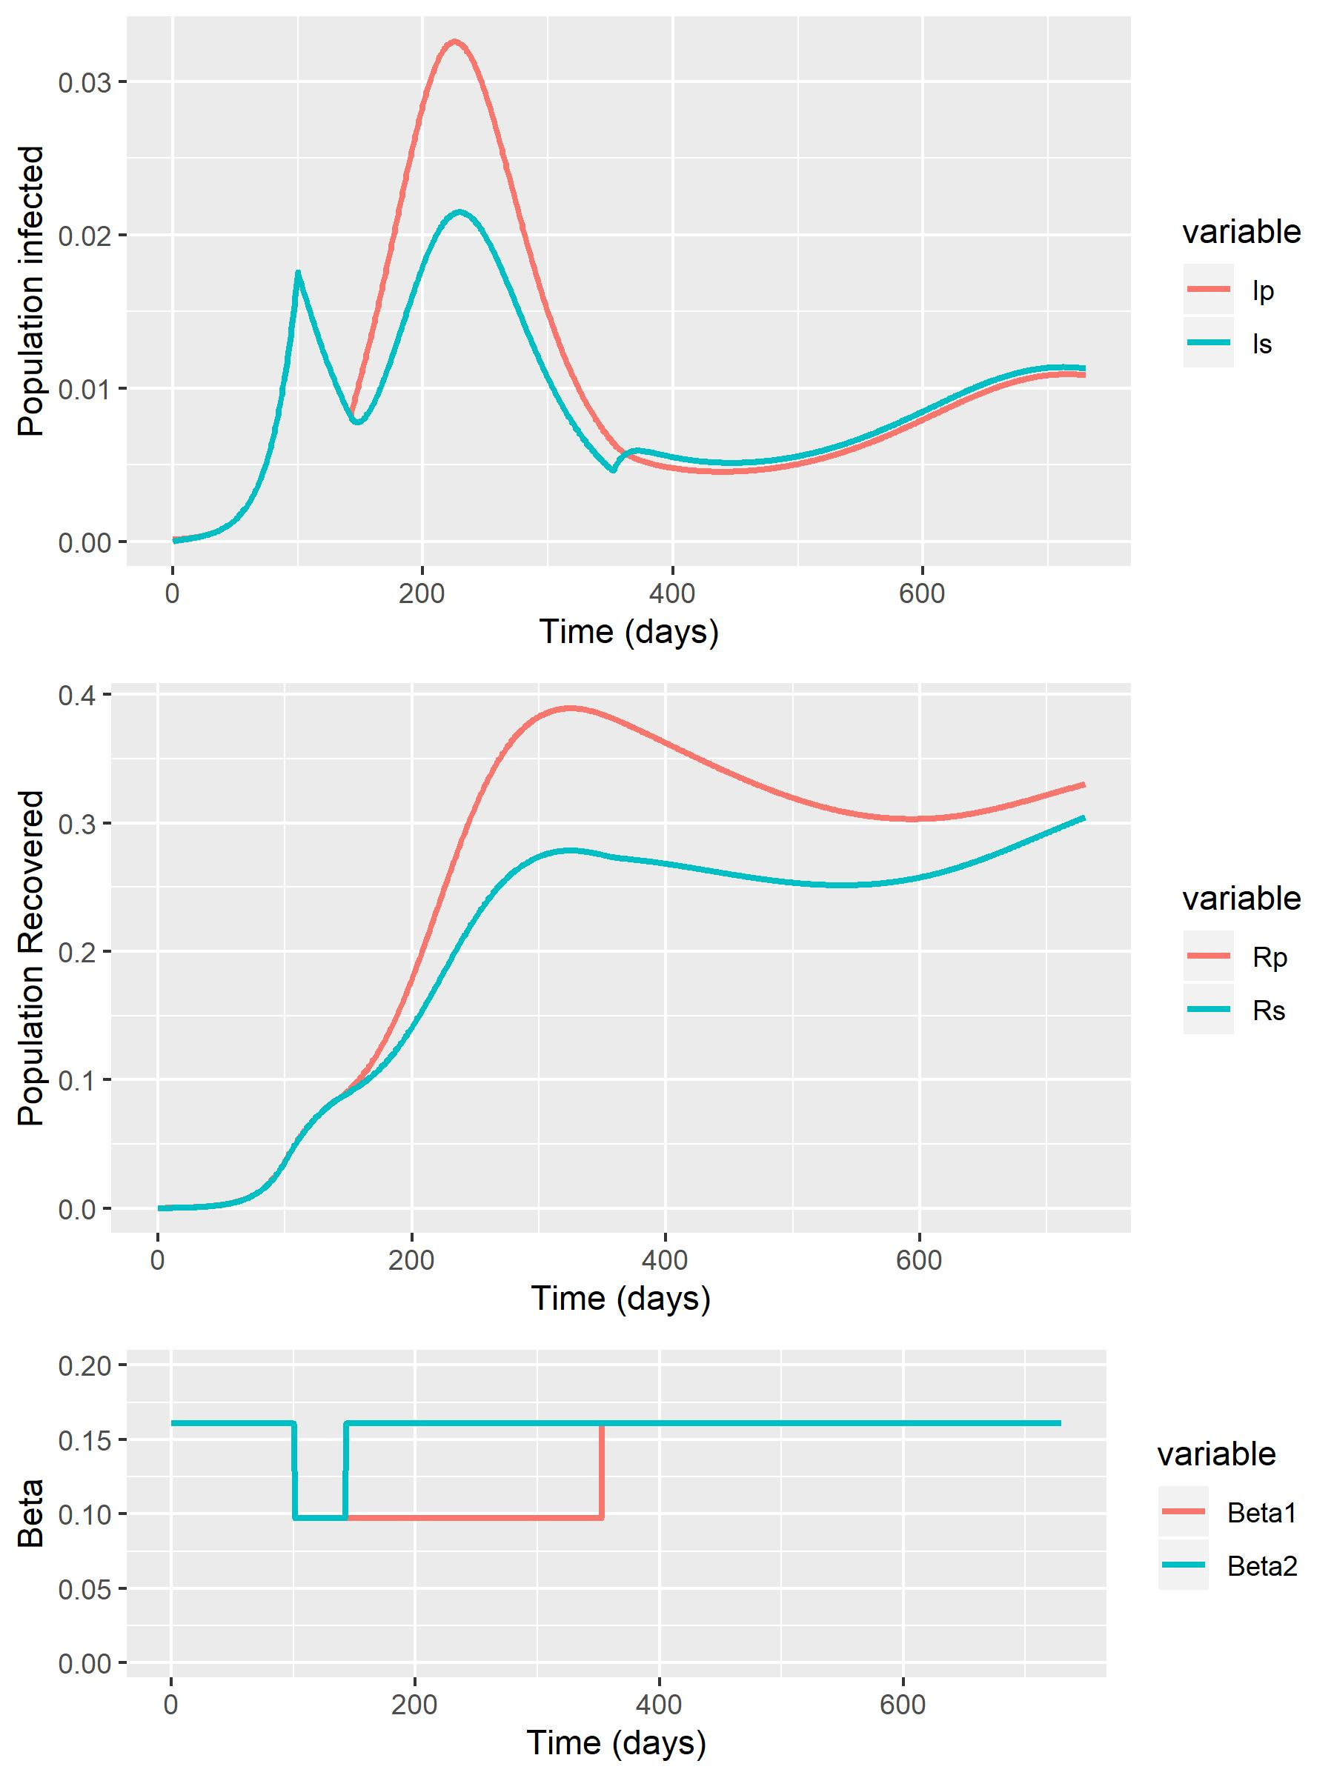
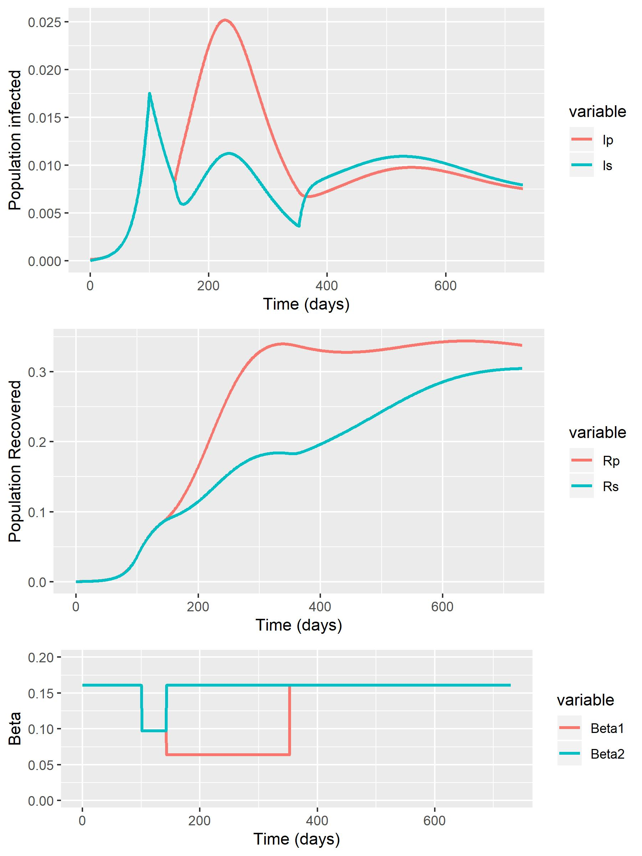
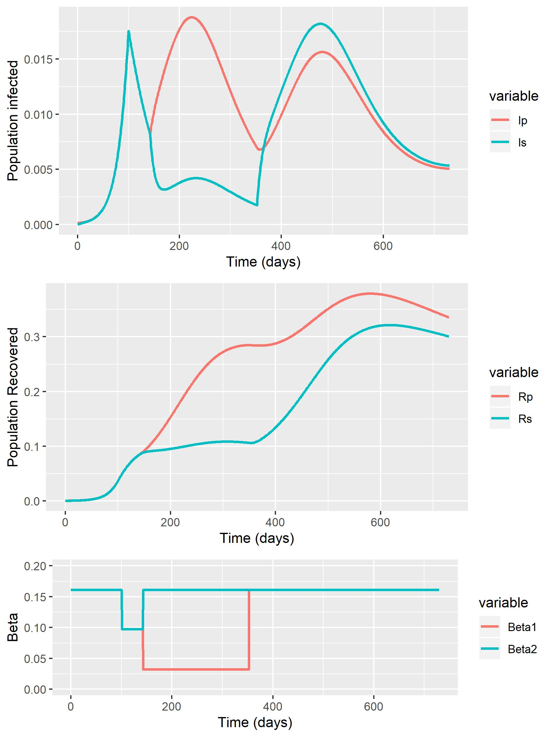
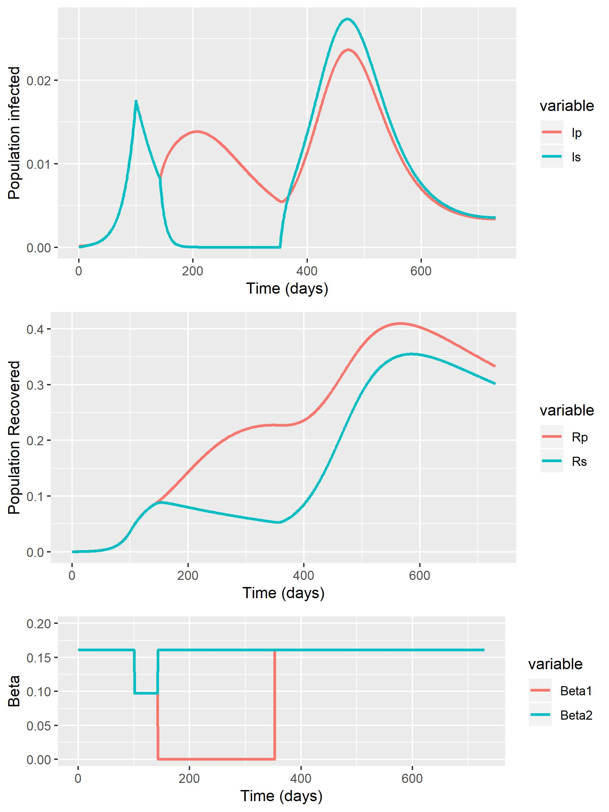
RWC + Baseline (0.064) – 2 Years (Base Timescale)
Phase 2 (Beta1 = 0.097)
Phase 2 (Beta1 = 0.064)
Phase 2 (Beta1 = 0.032)
Phase 2 (Beta1 = 0)

Slide 15
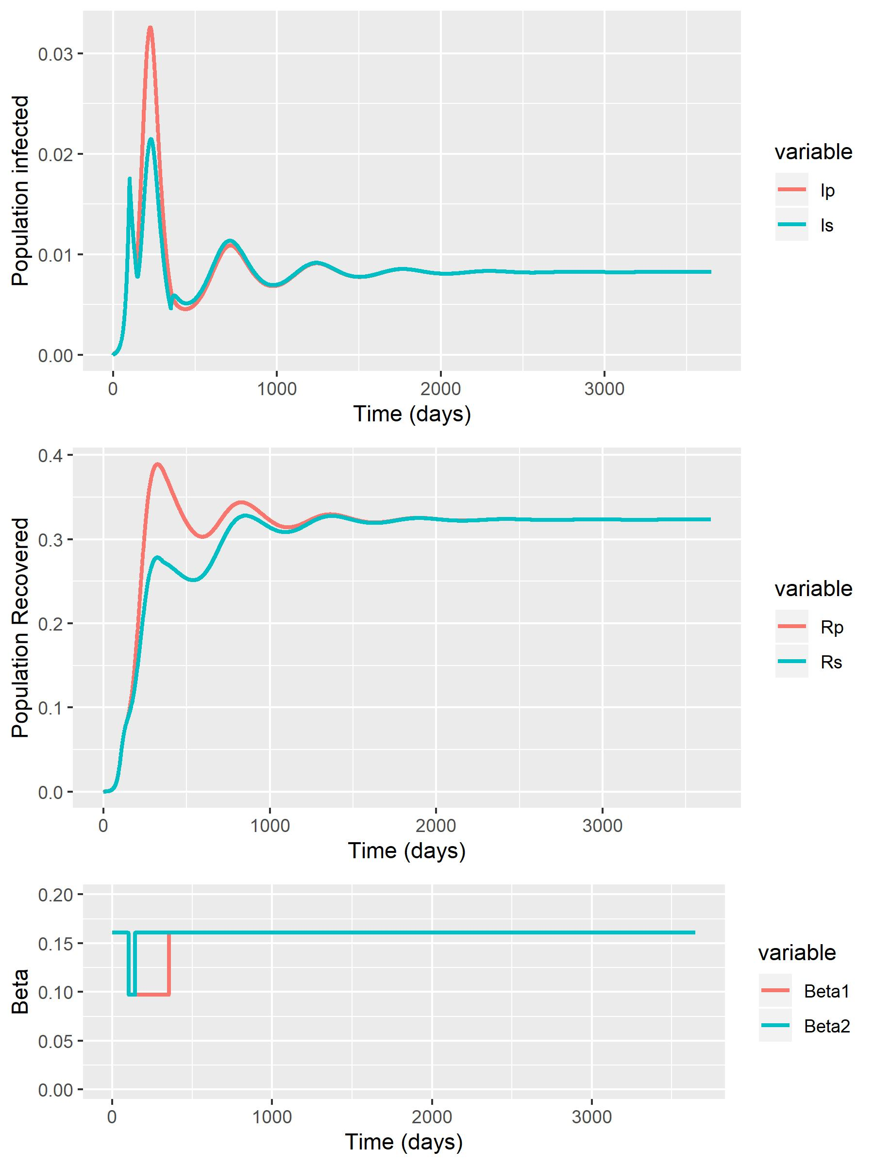
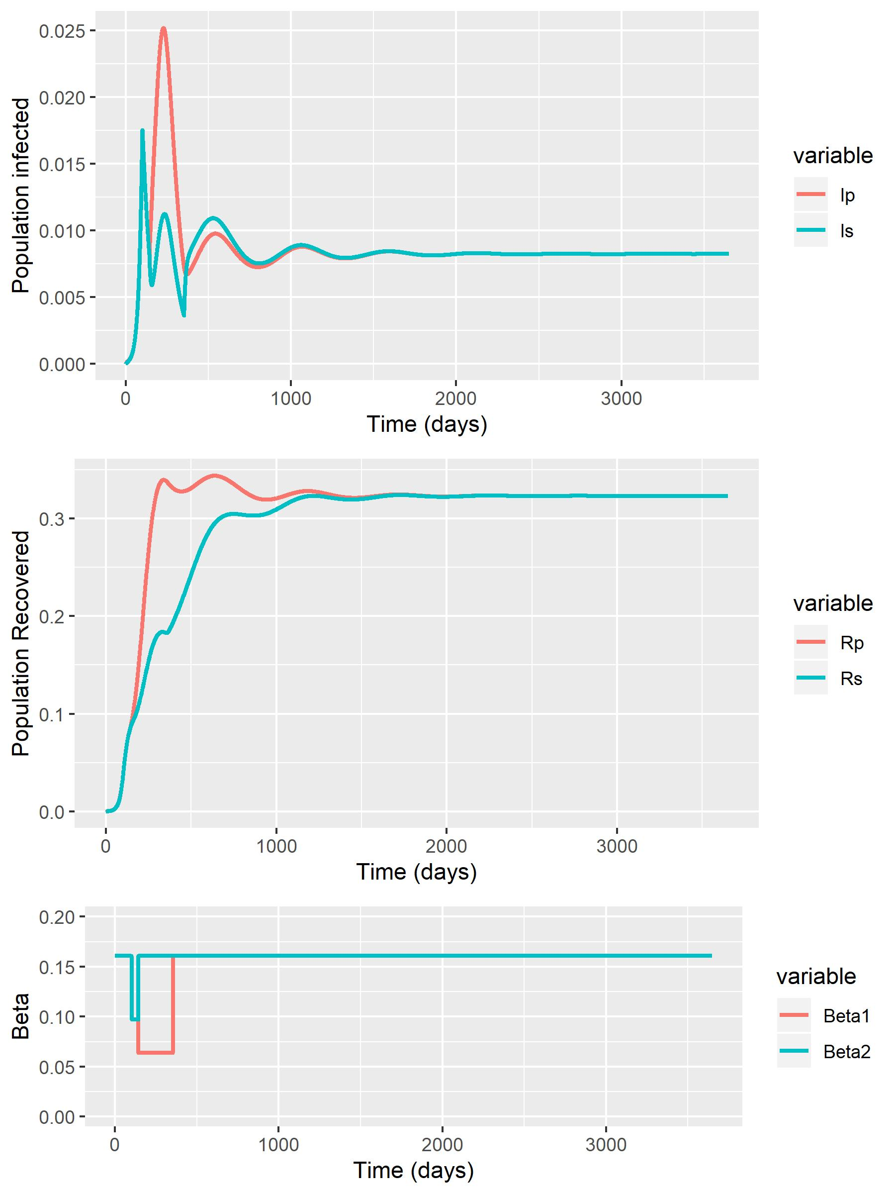
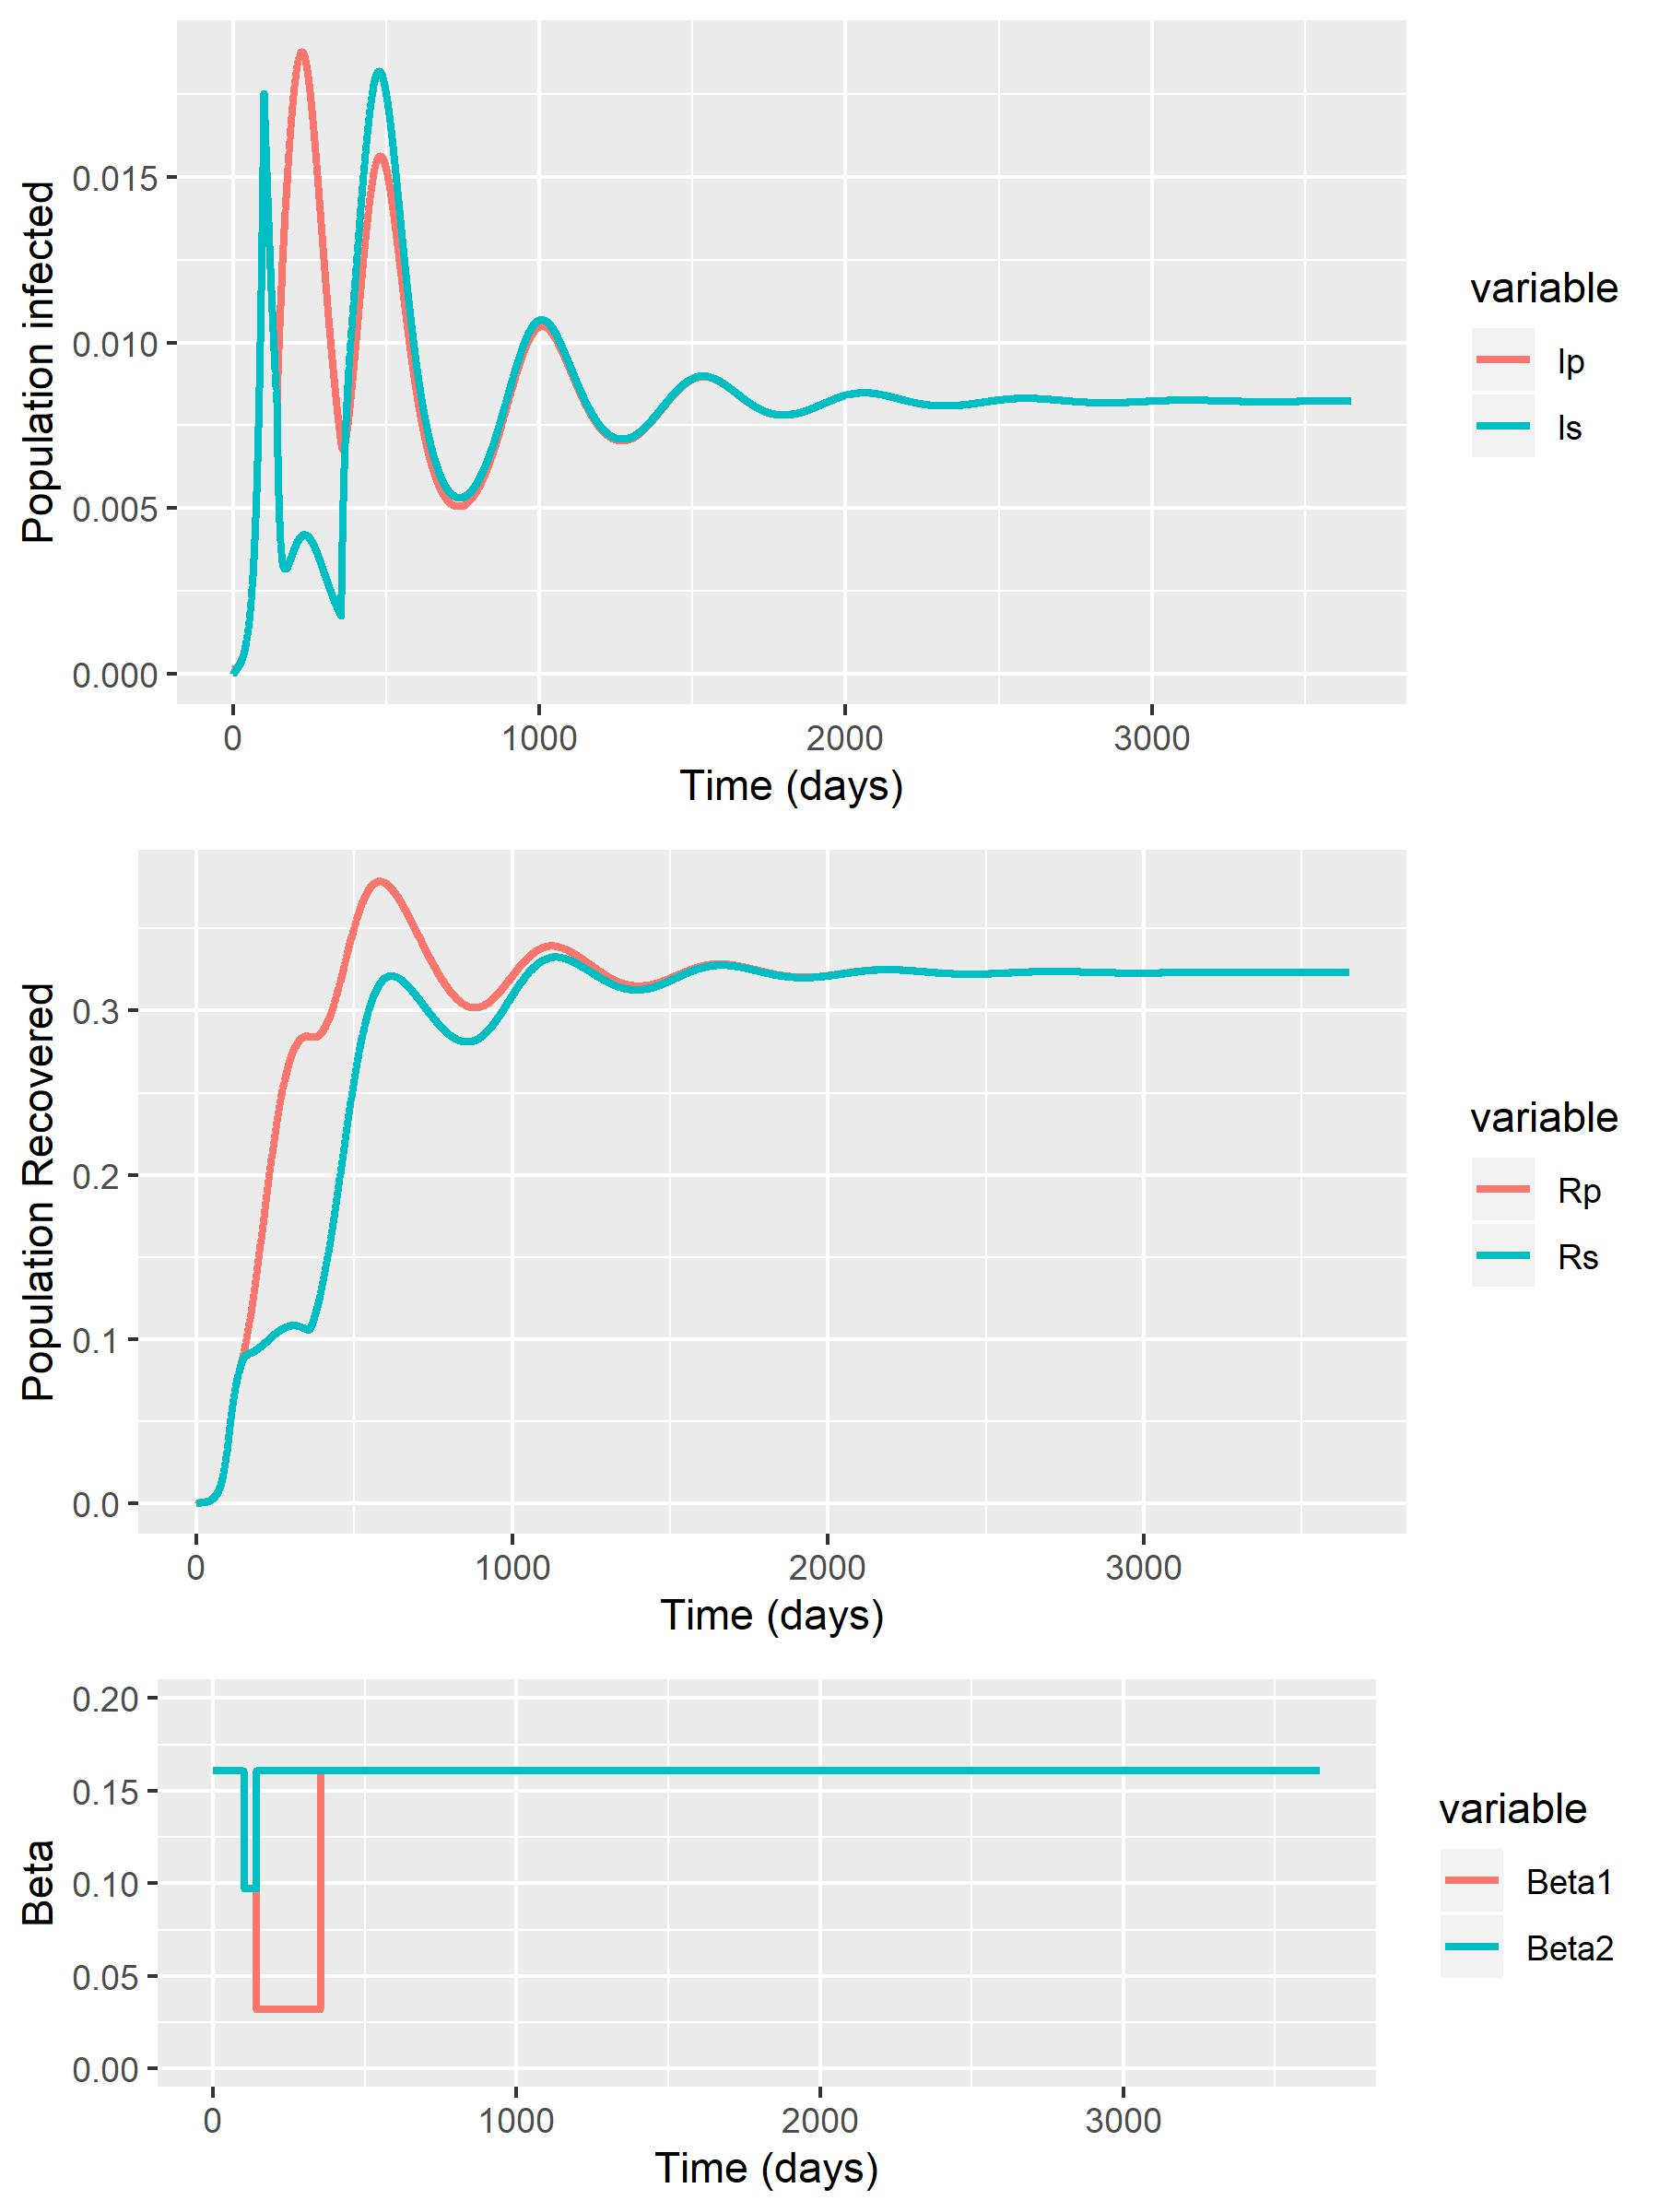
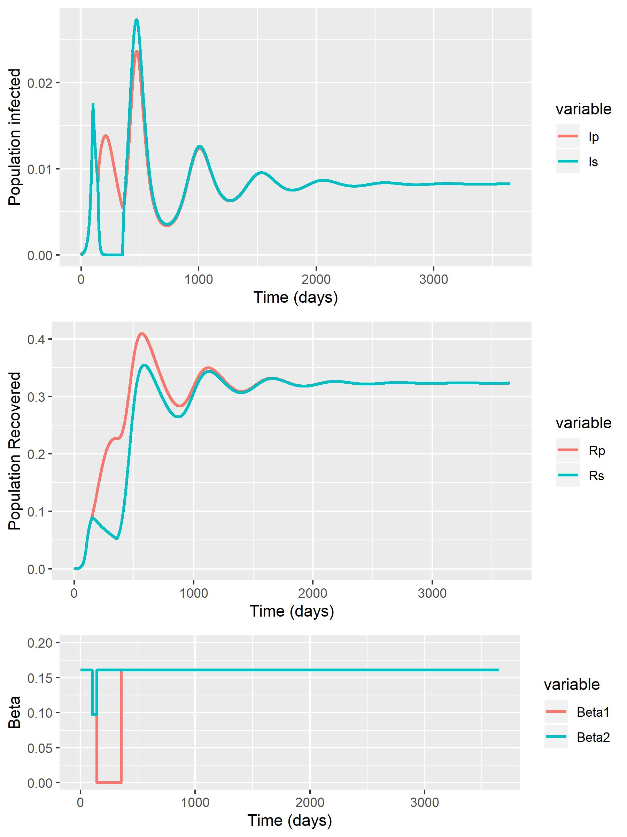
RWC + Baseline (0.064) – 10 Years (Timescale to observe Equilbrium)
Phase 2 (Beta1 = 0.097)
Phase 2 (Beta1 = 0.064)
Phase 2 (Beta1 = 0.032)
Phase 2 (Beta1 = 0)

Slide 16
Optimisation
Optimisations of baseline SIR model for the 3 different start points.
For the original SIR model we can optimise:
Relaxing to beta2=0.258 only in phase 4 [DONE]
Relaxing to beta2=0.258 in phases 3,4
Relaxing to beta2=0.258 in phases 2, 3, 4
SIRS Phase 2+3 intervention duration optimisation:
Explore optimising the intervention duration for the 4 different scenarios RWC, and the previous 3 scenarios (phase 2 beta1: 0.064, 0.032 and 0)
Explore the effect of optimising the SIRS model with differing trigger days (75, 100 and 125)

Slide 17
85-15 pop. structure

Slide 18
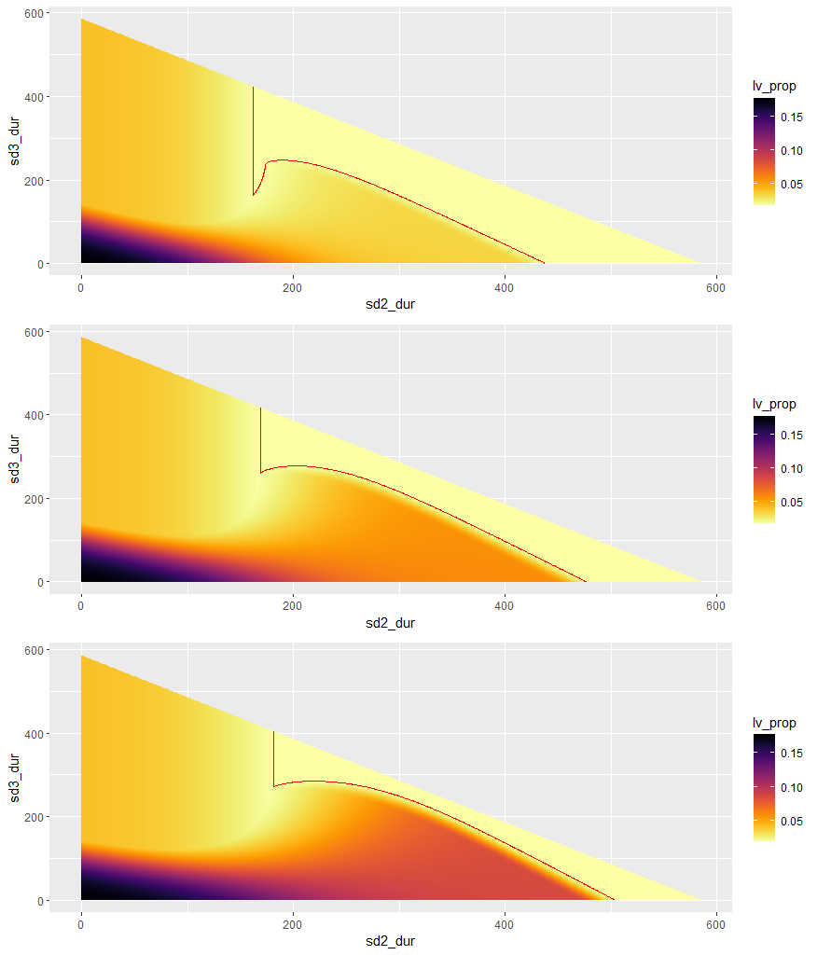
Baseline:
R₀ = 2.4
T₂ = 4.6
Red line in graphs show the value of Iv(100)=0.01825.
Phase 0 = 100 days
Phase 1 = 6 weeks
Phase | beta1 | beta2
0 | 0.161 | 0.161
1 | 0.064 | 0.064
2 | 0.064 | 0.161
3 | 0.161 | 0.161
4 | 0.258 | 0.258
Phase | beta1 | beta2
0 | 0.161 | 0.161
1 | 0.064 | 0.064
2 | 0.032 | 0.161
3 | 0.161 | 0.161
4 | 0.258 | 0.258
Phase | beta1 | Beta2
0 | 0.161 | 0.161
1 | 0.064 | 0.064
2 | 0.0 | 0.161
3 | 0.161 | 0.161
4 | 0.258 | 0.258

Slide 19
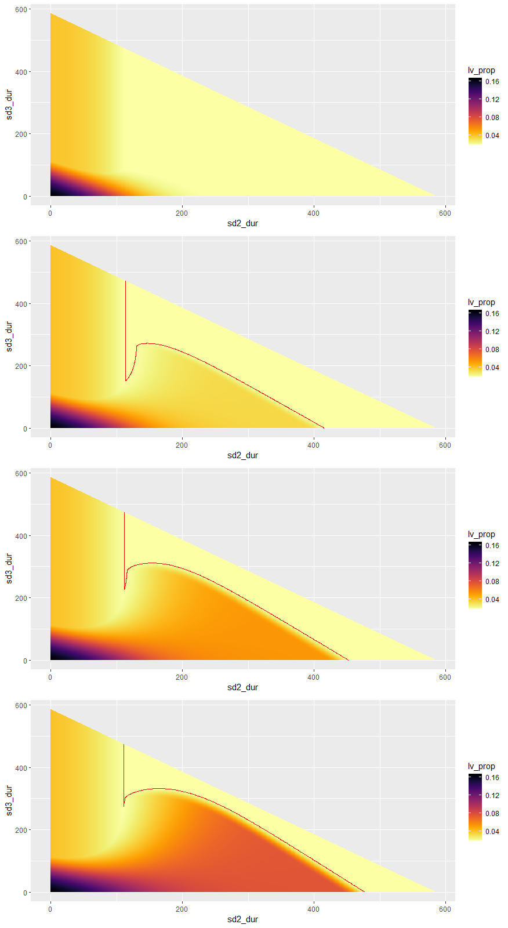
Phase | beta1 | beta2
0 | 0.161 | 0.161
1 | 0.097 | 0.097
2 | 0.097 | 0.161
3 | 0.161 | 0.161
4 | 0.258 | 0.258
RWC:
R₀ = 2.4
T₂ = 4.6
Red line in graphs show the value of Iv(100)=0.01825.
Phase 0 = 100 days
Phase 1 = 6 weeks
Phase | beta1 | beta2
0 | 0.161 | 0.161
1 | 0.097 | 0.097
2 | 0.064 | 0.161
3 | 0.161 | 0.161
4 | 0.258 | 0.258
Phase | beta1 | beta2
0 | 0.161 | 0.161
1 | 0.097 | 0.097
2 | 0.032 | 0.161
3 | 0.161 | 0.161
4 | 0.258 | 0.258
Phase | beta1 | beta2
0 | 0.161 | 0.161
1 | 0.097 | 0.097
2 | 0.0 | 0.161
3 | 0.161 | 0.161
4 | 0.258 | 0.258

Slide 20
80-20 pop. structure
SIR-model

Slide 21
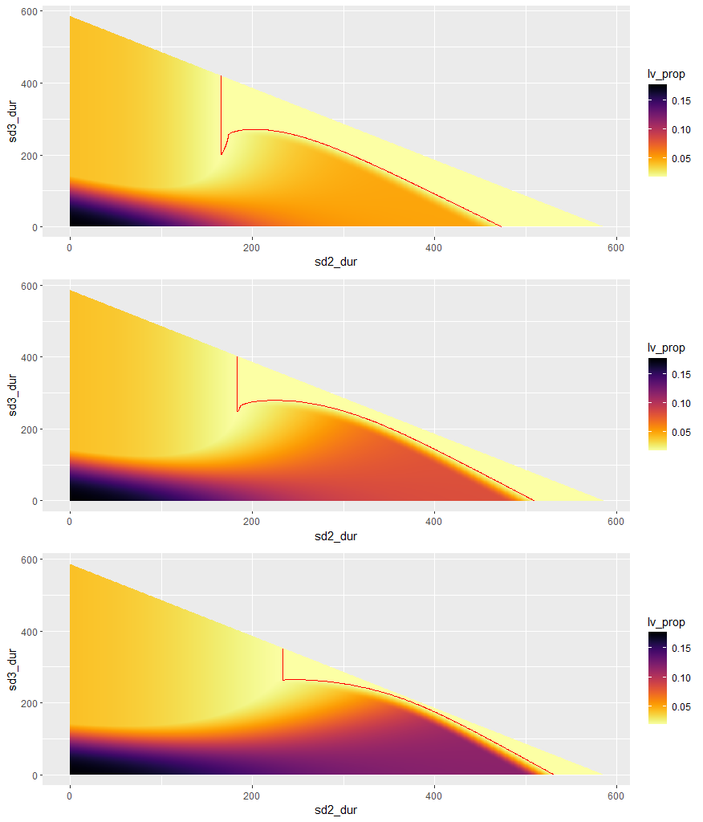
Baseline:
R₀ = 2.4
T₂ = 4.6
Red line in graphs show the value of Iv(100)=0.01825.
Phase 0 = 100 days
Phase 1 = 6 weeks
Phase | beta1 | beta2
0 | 0.161 | 0.161
1 | 0.064 | 0.064
2 | 0.064 | 0.161
3 | 0.161 | 0.161
4 | 0.258 | 0.258
Phase | beta1 | beta2
0 | 0.161 | 0.161
1 | 0.064 | 0.064
2 | 0.032 | 0.161
3 | 0.161 | 0.161
4 | 0.258 | 0.258
Optimal durations:
Scenario | Duration phase 2 | Duration phase 3
1 | 167 | 208
2 | 184 | 251
3 | 235 | 265
Phase | beta1 | Beta2
0 | 0.161 | 0.161
1 | 0.064 | 0.064
2 | 0.0 | 0.161
3 | 0.161 | 0.161
4 | 0.258 | 0.258

Slide 22
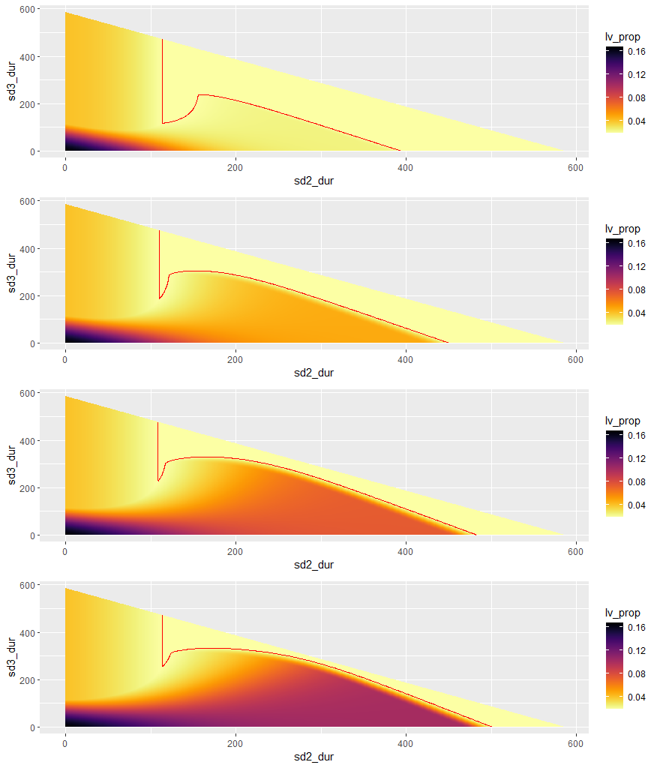
Phase | beta1 | beta2
0 | 0.161 | 0.161
1 | 0.097 | 0.097
2 | 0.097 | 0.161
3 | 0.161 | 0.161
4 | 0.258 | 0.258
RWC:
R₀ = 2.4
T₂ = 4.6
Red line in graphs show the value of Iv(100)=0.01825
Phase 0 = 100 days
Phase 1 = 6 weeks
Phase | beta1 | beta2
0 | 0.161 | 0.161
1 | 0.097 | 0.097
2 | 0.064 | 0.161
3 | 0.161 | 0.161
4 | 0.258 | 0.258
Phase | beta1 | beta2
0 | 0.161 | 0.161
1 | 0.097 | 0.097
2 | 0.032 | 0.161
3 | 0.161 | 0.161
4 | 0.258 | 0.258
Optimal durations:
Scenario | Duration phase 2 | Duration phase 3
1 | 114 | 118
2 | 110 | 189
3 | 109 | 231
4 | 115 | 261
Phase | beta1 | beta2
0 | 0.161 | 0.161
1 | 0.097 | 0.097
2 | 0.0 | 0.161
3 | 0.161 | 0.161
4 | 0.258 | 0.258

Slide 23
80-20 pop. structure
SIRS-model

Slide 24
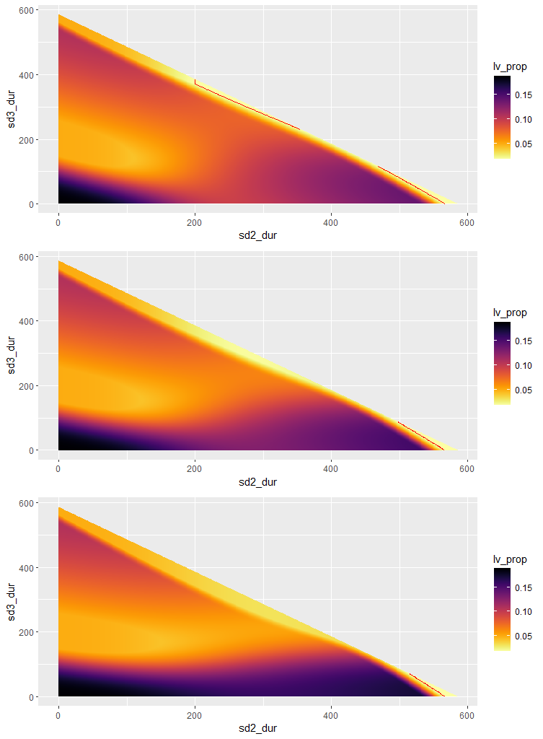
Baseline:
R₀ = 2.4
T₂ = 4.6
Red line in graphs show the value of Iv(100)=0.01825
Phase 0 = 100 days
Phase 1 = 6 weeks
Phase | beta1 | beta2
0 | 0.161 | 0.161
1 | 0.064 | 0.064
2 | 0.064 | 0.161
3 | 0.161 | 0.161
4 | 0.258 | 0.258
Phase | beta1 | beta2
0 | 0.161 | 0.161
1 | 0.064 | 0.064
2 | 0.032 | 0.161
3 | 0.161 | 0.161
4 | 0.258 | 0.258
Optimal durations:
Scenario | Duration phase 2 | Duration phase 3
1 | 200 | 371
2 | 493 | 92
3 | 512 | 73
Phase | beta1 | Beta2
0 | 0.161 | 0.161
1 | 0.064 | 0.064
2 | 0.0 | 0.161
3 | 0.161 | 0.161
4 | 0.258 | 0.258

Slide 25
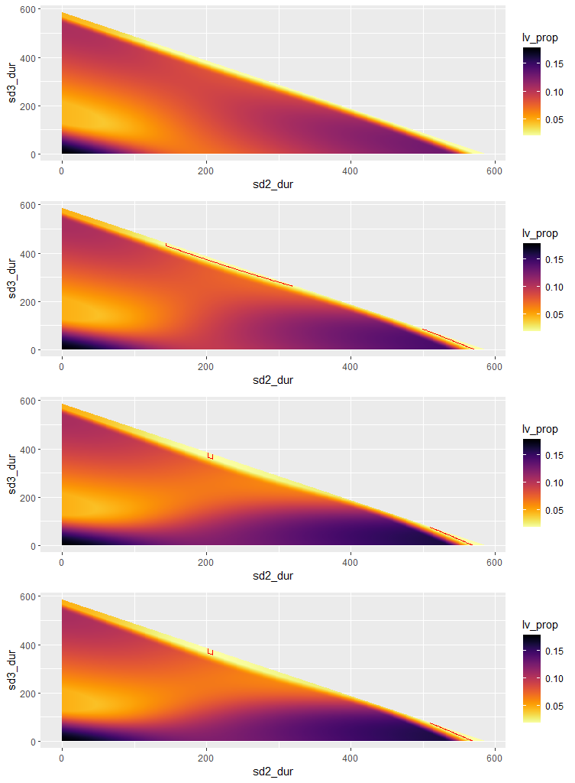
Phase | beta1 | beta2
0 | 0.161 | 0.161
1 | 0.097 | 0.097
2 | 0.097 | 0.161
3 | 0.161 | 0.161
4 | 0.258 | 0.258
RWC:
R₀ = 2.4
T₂ = 4.6
Red line in graphs show the value of Iv(100)=
Phase 0 = 100 days
Phase 1 = 6 weeks
Phase | beta1 | beta2
0 | 0.161 | 0.161
1 | 0.097 | 0.097
2 | 0.064 | 0.161
3 | 0.161 | 0.161
4 | 0.258 | 0.258
Phase | beta1 | beta2
0 | 0.161 | 0.161
1 | 0.097 | 0.097
2 | 0.032 | 0.161
3 | 0.161 | 0.161
4 | 0.258 | 0.258
Optimal durations:
Scenario | Duration phase 2 | Duration phase 3
1 | NA | NA
2 | 144 | 430
3 | 202 | 365
4 | 511 | 74
Phase | beta1 | beta2
0 | 0.161 | 0.161
1 | 0.097 | 0.097
2 | 0.0 | 0.161
3 | 0.161 | 0.161
4 | 0.258 | 0.258

Slide 26
Different starting points
SIR-model

Slide 27
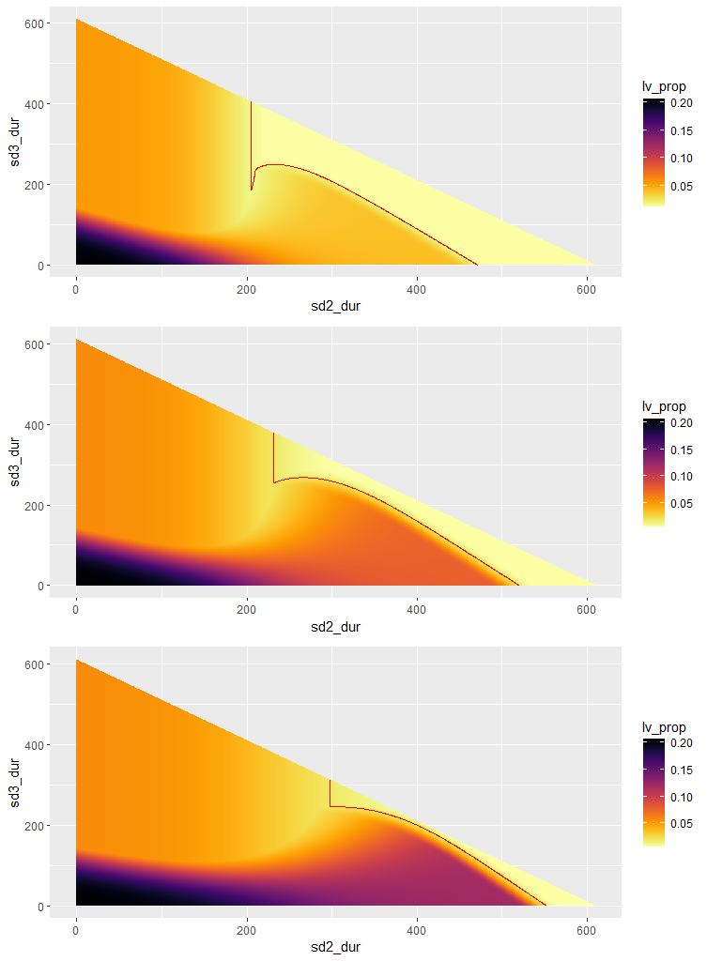
Baseline simulations:
Starting day phase 1: t=75
Baseline:
R₀ = 2.4
T₂ = 4.6
Red line in graphs show the value of 0.01825
Phase 0 = 75 days
Phase 1 = 6 weeks
Phase | beta1 | beta2
0 | 0.161 | 0.161
1 | 0.064 | 0.064
2 | 0.064 | 0.161
3 | 0.161 | 0.161
4 | 0.258 | 0.258
Phase | beta1 | beta2
0 | 0.161 | 0.161
1 | 0.064 | 0.064
2 | 0.032 | 0.161
3 | 0.161 | 0.161
4 | 0.258 | 0.258
Optimal durations:
Scenario | Duration phase 2 | Duration phase 3
1 | 205 | 187
2 | 232 | 255
3 | 298 | 246
Phase | beta1 | Beta2
0 | 0.161 | 0.161
1 | 0.064 | 0.064
2 | 0.0 | 0.161
3 | 0.161 | 0.161
4 | 0.258 | 0.258

Slide 28
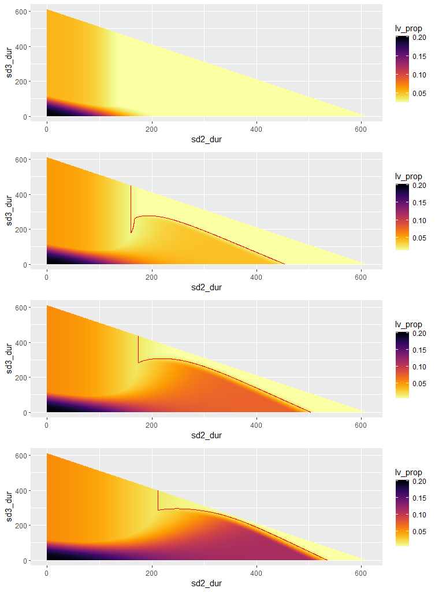
Phase | beta1 | beta2
0 | 0.161 | 0.161
1 | 0.097 | 0.097
2 | 0.097 | 0.161
3 | 0.161 | 0.161
4 | 0.258 | 0.258
RWC simulations:
Starting day phase 1: t=75
R₀ = 2.4
T₂ = 4.6
Red line in graphs show the value of 0.01825
Phase 0 = 75 days
Phase 1 = 6 weeks
Phase | beta1 | beta2
0 | 0.161 | 0.161
1 | 0.097 | 0.097
2 | 0.064 | 0.161
3 | 0.161 | 0.161
4 | 0.258 | 0.258
Phase | beta1 | beta2
0 | 0.161 | 0.161
1 | 0.097 | 0.097
2 | 0.032 | 0.161
3 | 0.161 | 0.161
4 | 0.258 | 0.258
Optimal durations:
Scenario | Duration phase 2 | Duration phase 3
1 | NA | NA
2 | 160 | 180
3 | 174 | 283
4 | 211 | 286
Phase | beta1 | beta2
0 | 0.161 | 0.161
1 | 0.097 | 0.097
2 | 0.0 | 0.161
3 | 0.161 | 0.161
4 | 0.258 | 0.258

Slide 29
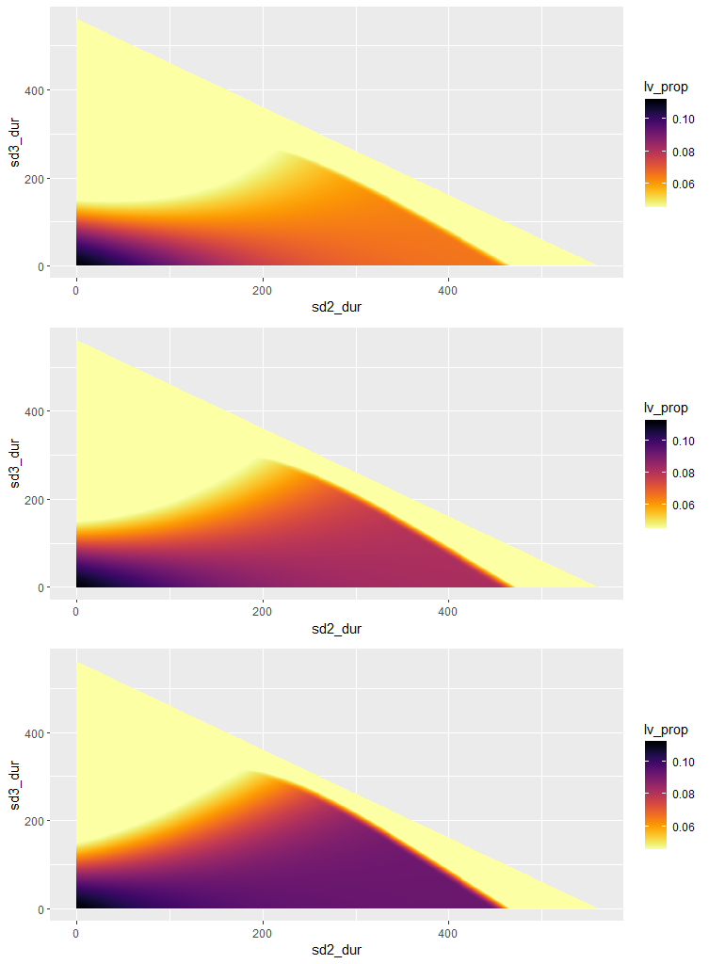
Baseline simulations:
Starting day phase 1: t=125
Baseline:
R₀ = 2.4
T₂ = 4.6
Red line in graphs show the value of 0.01285
Phase 0 = 125 days
Phase 1 = 6 weeks
Phase | beta1 | beta2
0 | 0.161 | 0.161
1 | 0.064 | 0.064
2 | 0.064 | 0.161
3 | 0.161 | 0.161
4 | 0.258 | 0.258
Phase | beta1 | beta2
0 | 0.161 | 0.161
1 | 0.064 | 0.064
2 | 0.032 | 0.161
3 | 0.161 | 0.161
4 | 0.258 | 0.258
Optimal durations:
Scenario | Duration phase 2 | Duration phase 3
1 | NA | NA
2 | NA | NA
3 | NA | NA
Phase | beta1 | Beta2
0 | 0.161 | 0.161
1 | 0.064 | 0.064
2 | 0.0 | 0.161
3 | 0.161 | 0.161
4 | 0.258 | 0.258

Slide 30
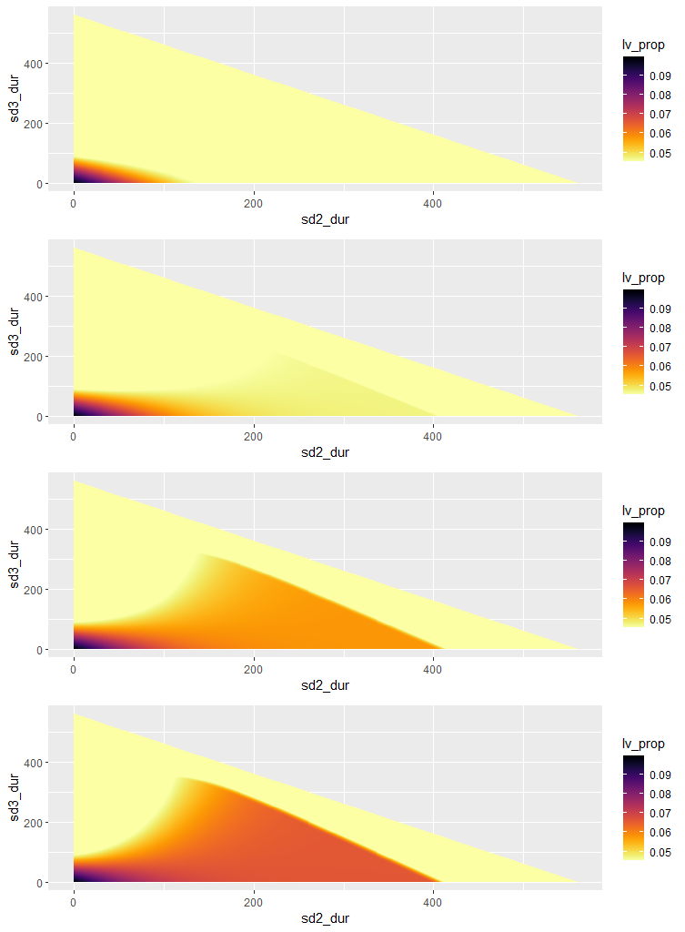
Phase | beta1 | beta2
0 | 0.161 | 0.161
1 | 0.097 | 0.097
2 | 0.097 | 0.161
3 | 0.161 | 0.161
4 | 0.258 | 0.258
RWC simulations:
Starting day phase 1: t=125
R₀ = 2.4
T₂ = 4.6
Red line in graphs show the value of 0.01825
Phase 0 = 125 days
Phase 1 = 6 weeks
Phase | beta1 | beta2
0 | 0.161 | 0.161
1 | 0.097 | 0.097
2 | 0.064 | 0.161
3 | 0.161 | 0.161
4 | 0.258 | 0.258
Phase | beta1 | beta2
0 | 0.161 | 0.161
1 | 0.097 | 0.097
2 | 0.032 | 0.161
3 | 0.161 | 0.161
4 | 0.258 | 0.258
Optimal durations:
Scenario | Duration phase 2 | Duration phase 3
1 | NA | NA
2 | NA | NA
3 | NA | NA
4 | NA | NA
Phase | beta1 | beta2
0 | 0.161 | 0.161
1 | 0.097 | 0.097
2 | 0.0 | 0.161
3 | 0.161 | 0.161
4 | 0.258 | 0.258

Slide 31
Different starting points
SIRS-model

Slide 32
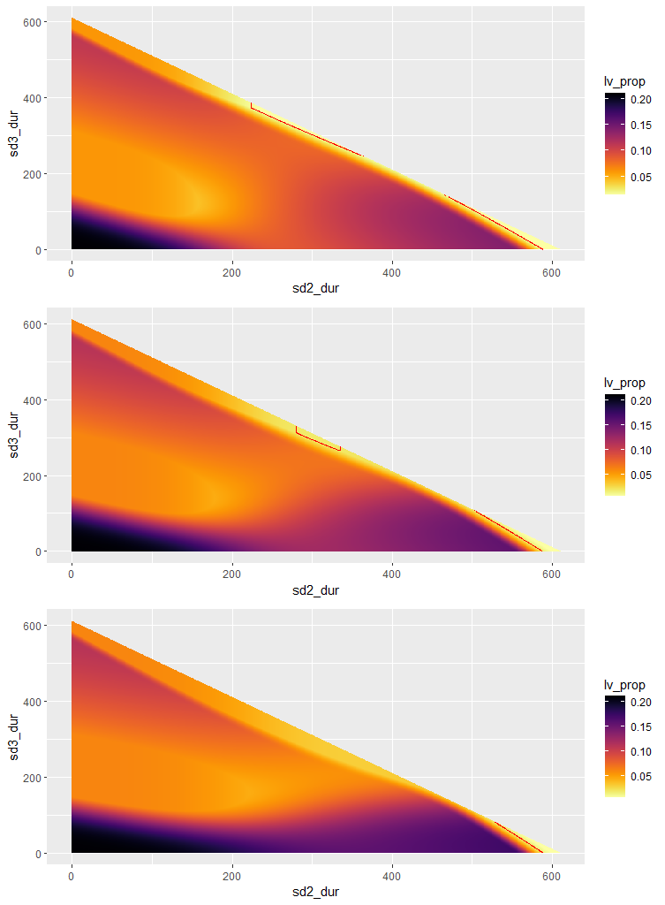
Baseline simulations:
Starting day phase 1: t=75
Baseline:
R₀ = 2.4
T₂ = 4.6
Red line in graphs show the value of 0.01825
Phase 0 = 75 days
Phase 1 = 6 weeks
Phase | beta1 | beta2
0 | 0.161 | 0.161
1 | 0.064 | 0.064
2 | 0.064 | 0.161
3 | 0.161 | 0.161
4 | 0.258 | 0.258
Phase | beta1 | beta2
0 | 0.161 | 0.161
1 | 0.064 | 0.064
2 | 0.032 | 0.161
3 | 0.161 | 0.161
4 | 0.258 | 0.258
Optimal durations:
Scenario | Duration phase 2 | Duration phase 3
1 | 224 | 374
2 | 280 | 313
3 | 527 | 83
Phase | beta1 | Beta2
0 | 0.161 | 0.161
1 | 0.064 | 0.064
2 | 0.0 | 0.161
3 | 0.161 | 0.161
4 | 0.258 | 0.258

Slide 33
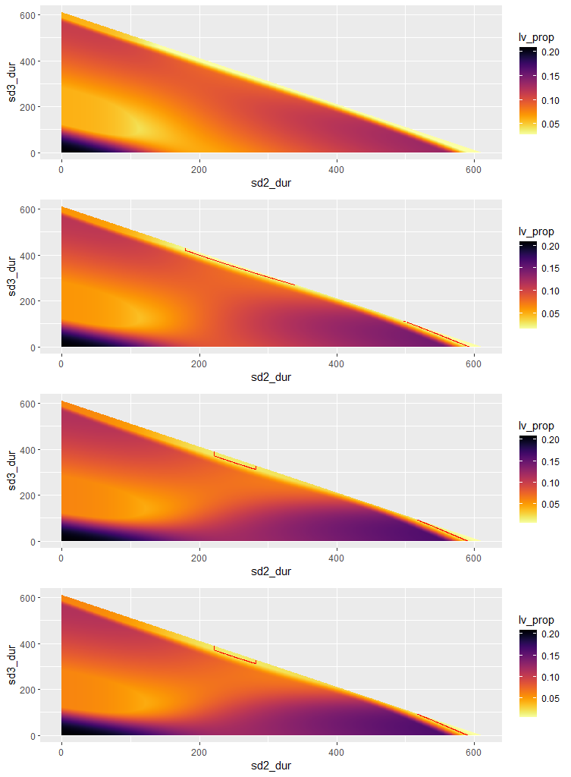
Phase | beta1 | beta2
0 | 0.161 | 0.161
1 | 0.097 | 0.097
2 | 0.097 | 0.161
3 | 0.161 | 0.161
4 | 0.258 | 0.258
RWC simulations:
Starting day phase 1: t=75
R₀ = 2.4
T₂ = 4.6
Red line in graphs show the value of 0.01825
Phase 0 = 75 days
Phase 1 = 6 weeks
Phase | beta1 | beta2
0 | 0.161 | 0.161
1 | 0.097 | 0.097
2 | 0.064 | 0.161
3 | 0.161 | 0.161
4 | 0.258 | 0.258
Phase | beta1 | beta2
0 | 0.161 | 0.161
1 | 0.097 | 0.097
2 | 0.032 | 0.161
3 | 0.161 | 0.161
4 | 0.258 | 0.258
Optimal durations:
Scenario | Duration phase 2 | Duration phase 3
1 | NA | NA
2 | 180 | 420
3 | 221 | 372
4 | 529 | 81
Phase | beta1 | beta2
0 | 0.161 | 0.161
1 | 0.097 | 0.097
2 | 0.0 | 0.161
3 | 0.161 | 0.161
4 | 0.258 | 0.258

Slide 34
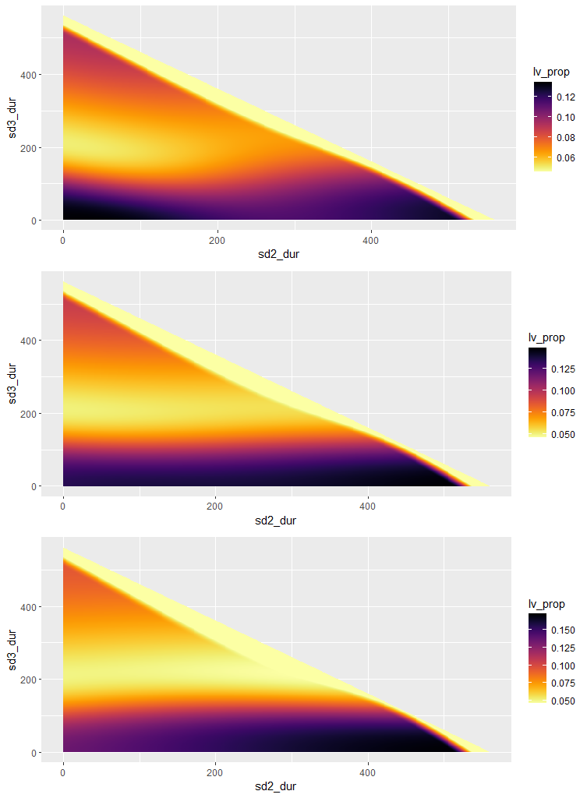
Baseline simulations:
Starting day phase 1: t=125
Baseline:
R₀ = 2.4
T₂ = 4.6
Red line in graphs show the value of 0.01825
Phase 0 = 125 days
Phase 1 = 6 weeks
Phase | beta1 | beta2
0 | 0.161 | 0.161
1 | 0.064 | 0.064
2 | 0.064 | 0.161
3 | 0.161 | 0.161
4 | 0.258 | 0.258
Phase | beta1 | beta2
0 | 0.161 | 0.161
1 | 0.064 | 0.064
2 | 0.032 | 0.161
3 | 0.161 | 0.161
4 | 0.258 | 0.258
Optimal durations:
Scenario | Duration phase 2 | Duration phase 3
1 | NA | NA
2 | NA | NA
3 | NA | NA
Phase | beta1 | Beta2
0 | 0.161 | 0.161
1 | 0.064 | 0.064
2 | 0.0 | 0.161
3 | 0.161 | 0.161
4 | 0.258 | 0.258

Slide 35
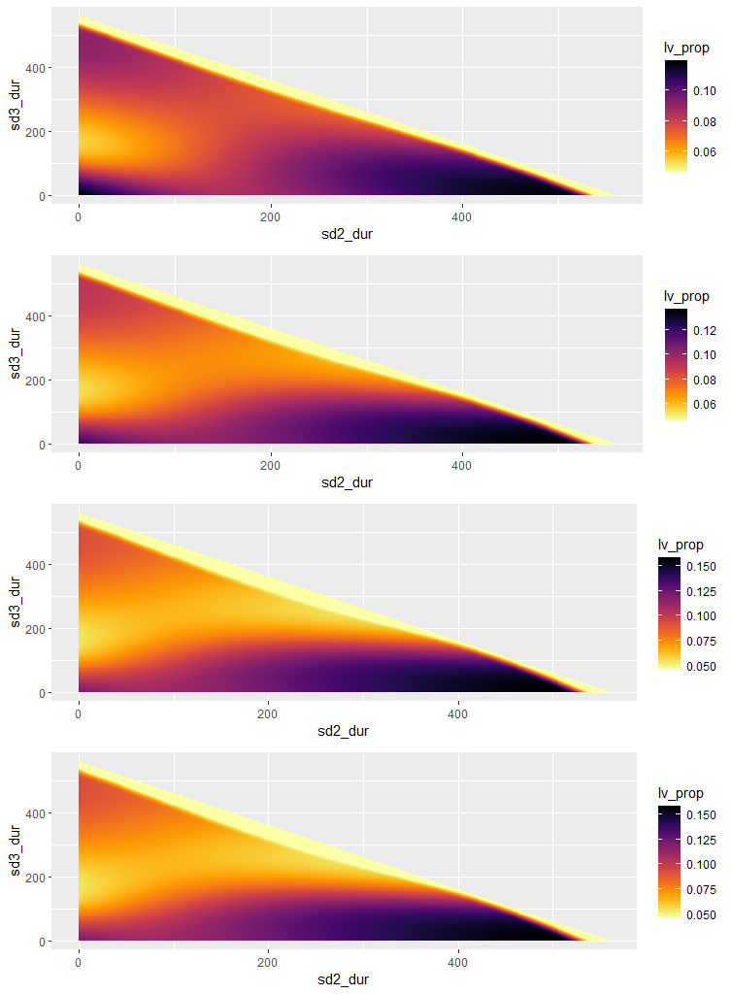
Phase | beta1 | beta2
0 | 0.161 | 0.161
1 | 0.097 | 0.097
2 | 0.097 | 0.161
3 | 0.161 | 0.161
4 | 0.258 | 0.258
RWC simulations:
Starting day phase 1: t=125
R₀ = 2.4
T₂ = 4.6
Red line in graphs show the value of 0.01825
Phase 0 = 125 days
Phase 1 = 6 weeks
Phase | beta1 | beta2
0 | 0.161 | 0.161
1 | 0.097 | 0.097
2 | 0.064 | 0.161
3 | 0.161 | 0.161
4 | 0.258 | 0.258
Phase | beta1 | beta2
0 | 0.161 | 0.161
1 | 0.097 | 0.097
2 | 0.032 | 0.161
3 | 0.161 | 0.161
4 | 0.258 | 0.258
Optimal durations:
Scenario | Duration phase 2 | Duration phase 3
1 | NA | NA
2 | NA | NA
3 | NA | NA
4 | NA | NA
Phase | beta1 | beta2
0 | 0.161 | 0.161
1 | 0.097 | 0.097
2 | 0.0 | 0.161
3 | 0.161 | 0.161
4 | 0.258 | 0.258

Slide 36
Relaxing beta2

Slide 37
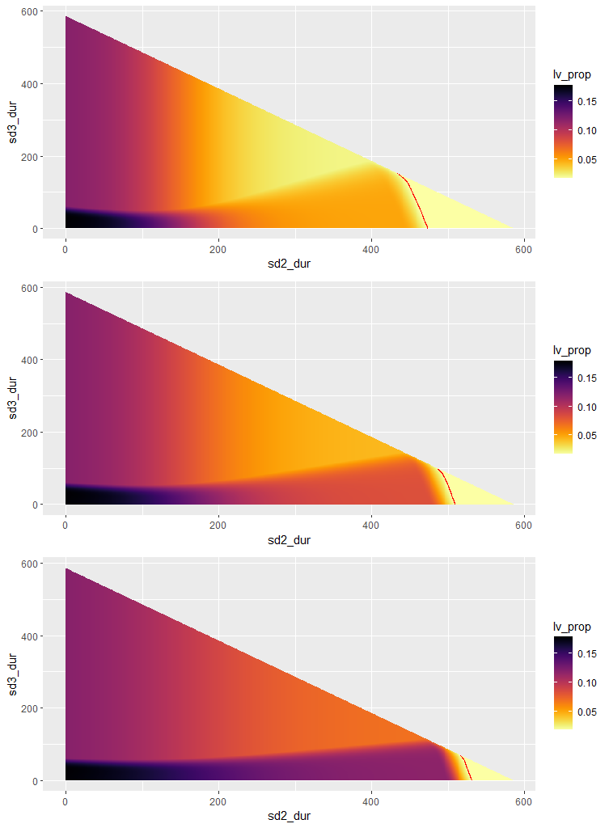
Phase | beta1 | beta2
0 | 0.161 | 0.161
1 | 0.064 | 0.064
2 | 0.064 | 0.161
3 | 0.161 | 0.258
4 | 0.258 | 0.258
Relax phase 3+4
Phase | beta1 | beta2
0 | 0.161 | 0.161
1 | 0.064 | 0.064
2 | 0.032 | 0.161
3 | 0.161 | 0.258
4 | 0.258 | 0.258
Optimal durations:
Scenario | Duration phase 2 | Duration phase 3
1 | 434 | 151
2 | 486 | 99
3 | 515 | 70
Phase | beta1 | Beta2
0 | 0.161 | 0.161
1 | 0.064 | 0.064
2 | 0.0 | 0.161
3 | 0.161 | 0.258
4 | 0.258 | 0.258

Slide 38
